Slide 1
What other organisms do MICROBIOLOGISTS study?
OTHER MICROORGANISMS
Notebook page 27

Slide 2
Warm Up 3/14/2017
1. What are three types of Fungi?
2. A mushroom is a(n)
photosynthesizing fungi
multicellular prokaryote
unicellular eukaryote
non-photosynthesizing fungus
3. Which one of the following is true about fungi:
they can reproduce sexually or asexually
some can photosynthesize
their cells can be prokaryotic or eukaryotic
they are mostly unicellular
Objectives: 8.L.1.1- TSW understand the similarities and differences b/w Bacteria, Viruses, Parasites, and Fungi.
Essential Question – How are Fungi different than bacteria, viruses, and parasites?

Slide 3
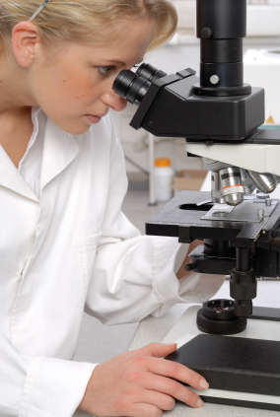
What other organisms do MICROBIOLOGISTS study?

Slide 4
MICRObiology studies…

Slide 5
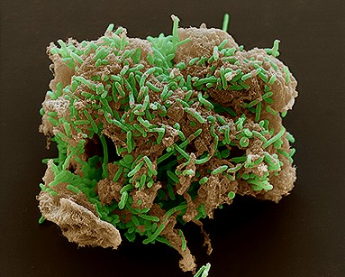
Microbiologists study…
bacteria…

Slide 6
MICRObiology studies…
bacteria…
smallest living thing

Slide 7
MICRObiology studies…
bacteria…
smallest living thing
unicellular prokaryote

Slide 8
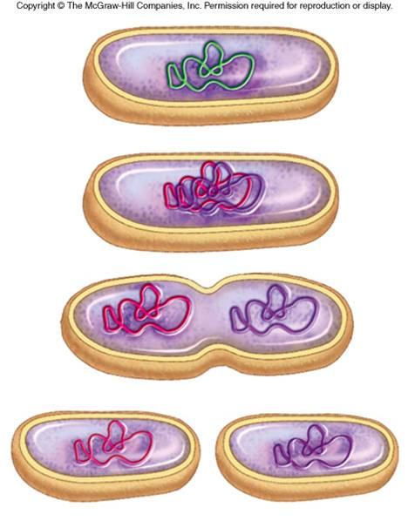
MICRObiology studies…
bacteria…
smallest living thing
unicellular prokaryote
reproduces FAST through binary fission

Slide 9
MICRObiology studies…
bacteria…
viruses…
smallest living thing
unicellular prokaryote
reproduces FAST through binary fission
http://www.youtube.com/watch?v=9hzUjx_oD8E

Slide 10
MICRObiology studies…
bacteria…
viruses…
smallest living thing
unicellular prokaryote
reproduces FAST through binary fission
non-living—

Slide 11
MICRObiology studies…
bacteria…
viruses…
smallest living thing
unicellular prokaryote
reproduces FAST through binary fission
non-living—can’t reproduce

Slide 12
MICRObiology studies…
bacteria…
viruses…
smallest living thing
unicellular prokaryote
reproduces FAST through binary fission
non-living—can’t reproduce
needs to reprogram a “host” cell & force it to make viruses

Slide 13
But WAIT! There’s MORE!

Slide 14
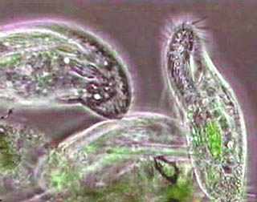
MICRObiology studies…
PROTOZOA –AKA, Protists

Slide 15
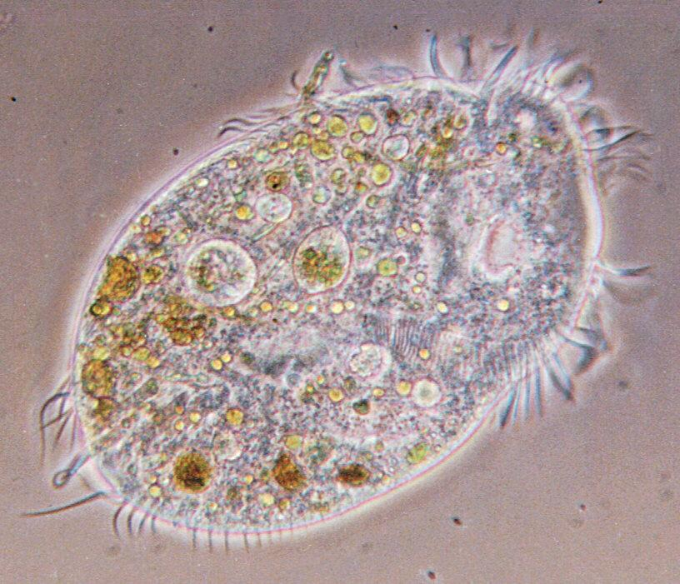
MICRObiology studies…
PROTOZOA
found in natural waters,

Slide 16
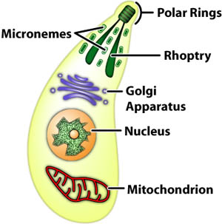
MICRObiology studies…
PROTOZOA
found in natural waters,
unicellular EUKARYOTE!

Slide 17
MICRObiology studies…
PROTOZOA- also known as protists
found in natural waters,
unicellular EUKARYOTE!
can cause some diseases

Slide 18
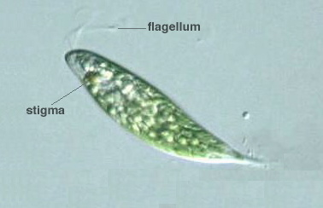
MICRObiology studies…
PROTOZOA
FUNGI
found in natural waters,
unicellular EUKARYOTE!
can cause some diseases

Slide 19
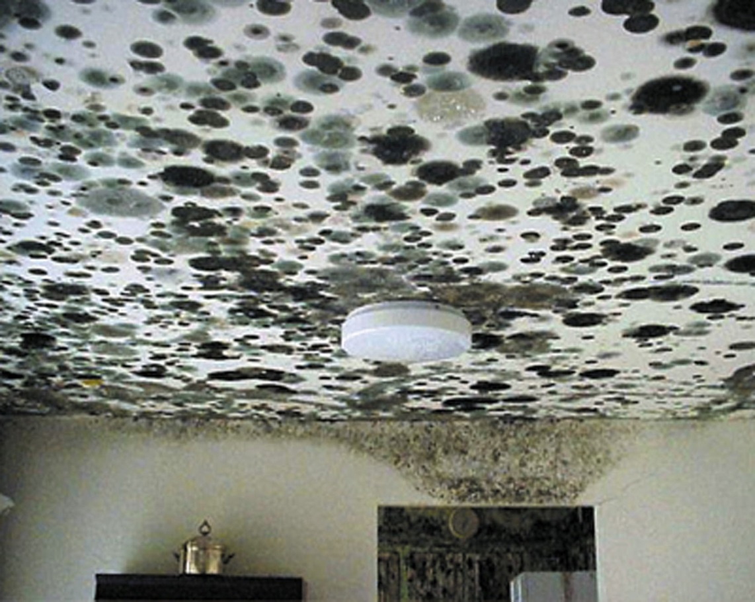
MICRObiology studies…
FUNGI
found in natural waters,
unicellular EUKARYOTE!
can cause some diseases
molds &

Slide 20
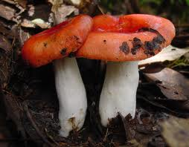
MICRObiology studies…
FUNGI
found in natural waters,
unicellular EUKARYOTE!
can cause some diseases
molds & mushrooms

Slide 21
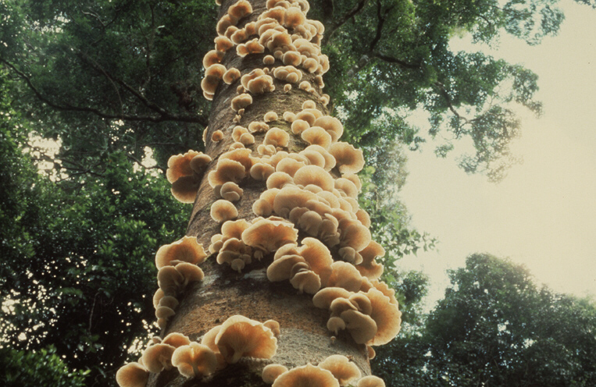
MICRObiology studies…
FUNGI
found in natural waters,
unicellular EUKARYOTE!
can cause some diseases
molds & mushrooms
multicellular, non-photosynthesizing EUKARYOTES

Slide 22
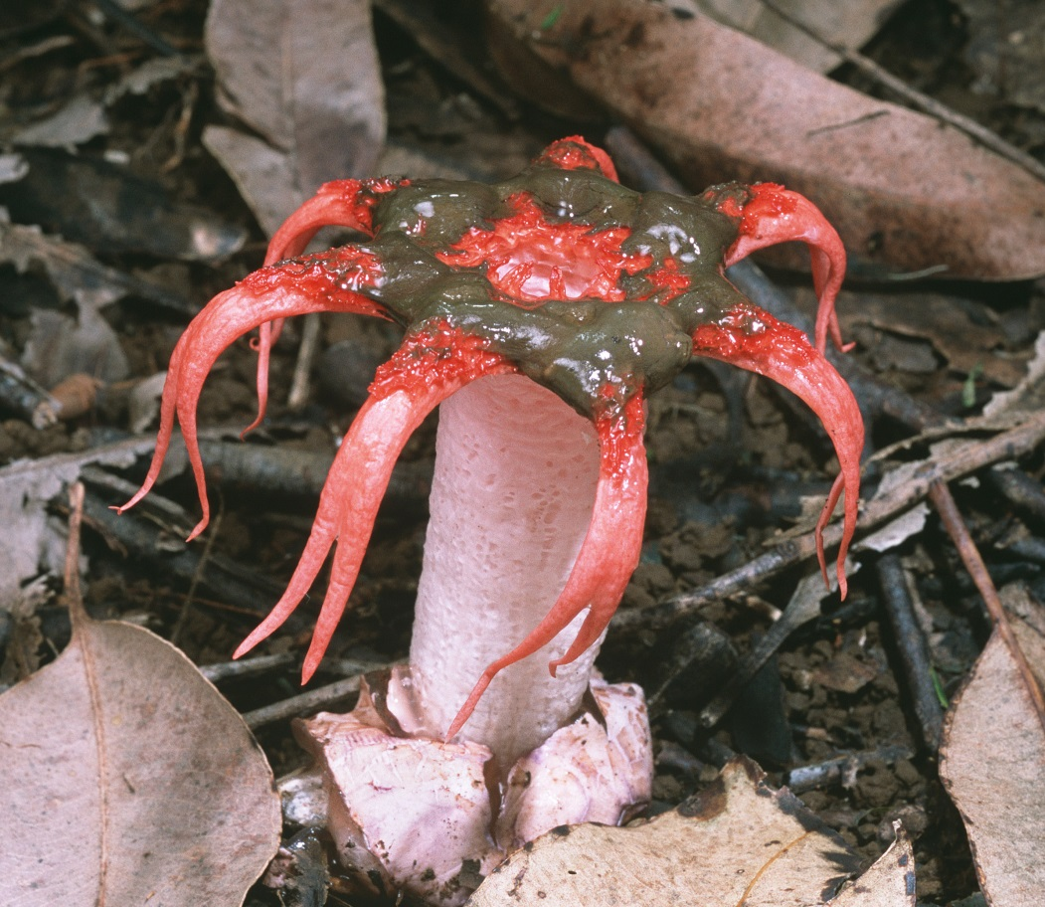
MICRObiology studies…
FUNGI
found in natural waters,
unicellular EUKARYOTE!
can cause some diseases
molds & mushrooms
multicellular, non-photosynthesizing EUKARYOTES

Slide 23
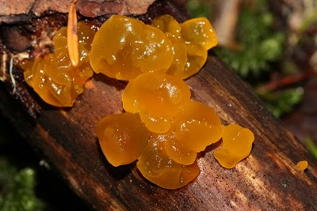
MICRObiology studies…
FUNGI
found in natural waters,
unicellular EUKARYOTE!
can cause some diseases
molds & mushrooms
multicellular, non-photosynthesizing EUKARYOTES

Slide 24
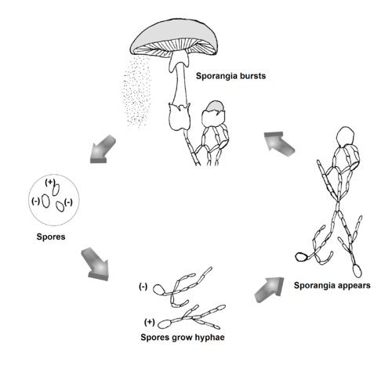
MICRObiology studies…
FUNGI
found in natural waters,
unicellular EUKARYOTE!
can cause some diseases
molds & mushrooms
multicellular, non-photosynthesizing EUKARYOTES
can reproduce asexually (spores) OR

Slide 25
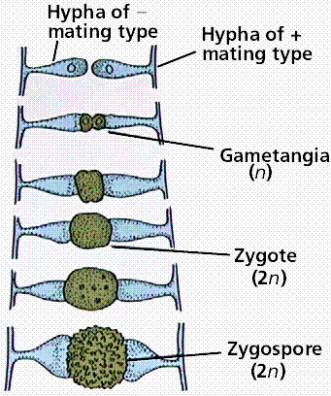
MICRObiology studies…
FUNGI
found in natural waters,
unicellular EUKARYOTE!
can cause some diseases
molds & mushrooms
multicellular, non-photosynthesizing EUKARYOTES
can reproduce asexually (spores) OR sexually (exchanging genetic info with a neighboring fungi)
Yeast – the only unicellular eukaryotic fungi

Slide 26
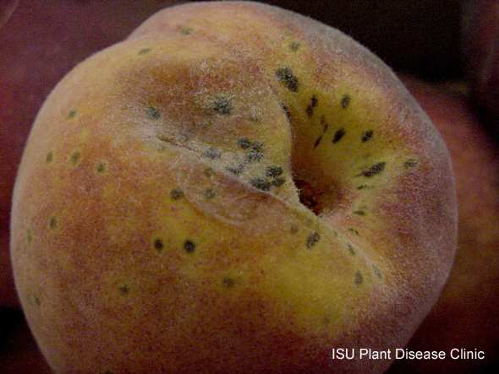
MICRObiology studies…
FUNGI
found in natural waters,
unicellular EUKARYOTE!
can cause some diseases
Sometimes attack living plants and animals, causing disease

Slide 27
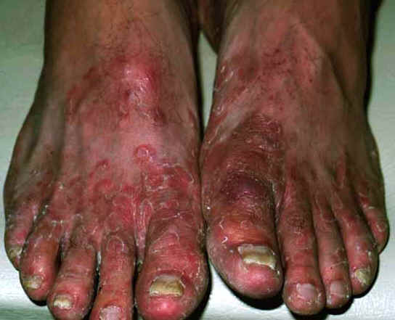
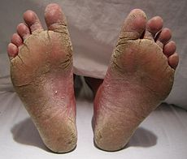
Athletes Foot
Fungal infection in feet that is usually transmitted in moist, communal areas. Also known as ringworm of the foot.

Slide 28
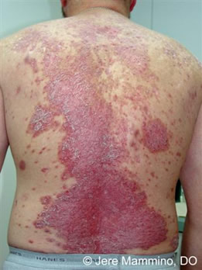
MICRObiology studies…
PROTOZOA
FUNGI
found in natural waters,
unicellular EUKARYOTE!
can cause some diseases
Sometimes attack living tissue, causing disease

Slide 29
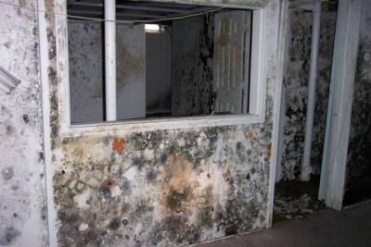
MICRObiology studies…
PROTOZOA
FUNGI
found in natural waters,
unicellular EUKARYOTE!
can cause some diseases
Sometimes attack living tissue, causing disease
Mold spores are released by fungi and cause allergic reactions in humans

Slide 30
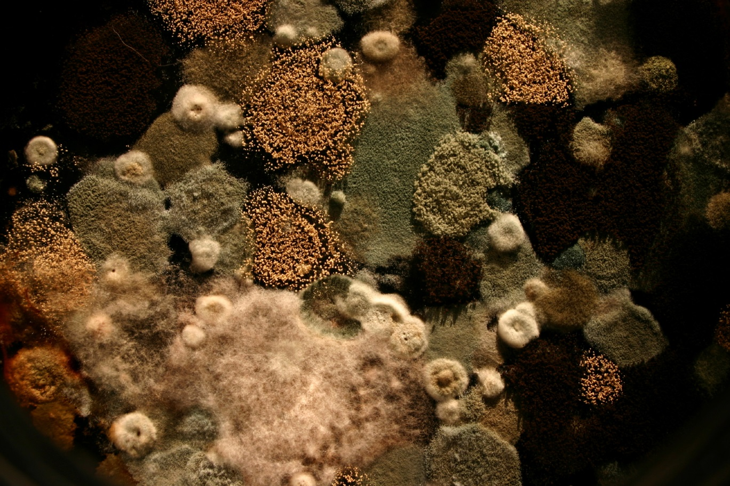
MICRObiology studies…
PROTOZOA
FUNGI
found in natural waters,
unicellular EUKARYOTE!
can cause some diseases
Sometimes attack living tissue, causing disease
Mold spores are released by fungi and cause allergic reactions in humans

Slide 31
MICRObiology studies…
PROTOZOA
FUNGI
found in natural waters,
unicellular EUKARYOTE!
can cause some diseases
Sometimes attack living tissue, causing disease
Mold spores are released by fungi and cause allergic reactions in humans

Slide 32
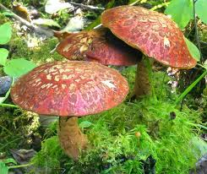
MICRObiology studies…
PROTOZOA
FUNGI
http://www.youtube.com/watch?v=CibGFo0RHIw
https://www.youtube.com/watch?v=LHk5Tg8yRGo

Slide 33
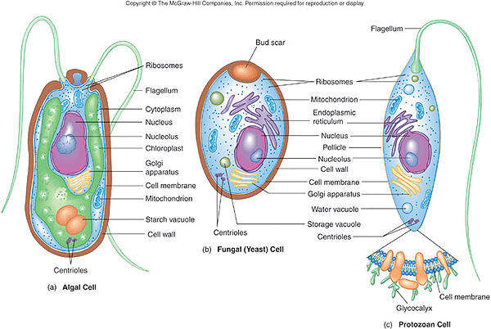

Slide 35
1) Title Page :
-Bacteria, Viruses, and Other Microorganisms
-Name, date, and block
-1 Colored picture with a caption
2) Five Tabs
-Title each tab
-5 facts per tab
-1 colored picture with a caption per tab
3) Reflection 1-8
Write and answer each…
Bacteria, viruses, and other microorganisms
Name, Date, Block
Bacteria
Viruses
Fungi
Parasites
Reflection

Slide 36
1) Title Page :
-Bacteria, Viruses, and Other Microorganisms
-Name, date, and block
-1 Colored picture with a caption
2) Five Tabs
-Title each tab
-5 facts per tab
-1 colored picture with a caption per tab
3) Reflection 1-8
Write and answer each…
Bacteria, viruses, and other microorganisms
Name, Date, Block
Bacteria
Viruses
Fungi
Parasites
Reflection

Slide 37
Bacteria, Viruses and Other… Reflection
Name 2 features that all bacteria share.
What three shapes can bacteria have?
How can bacteria be helpful? How can they be harmful?
How does a virus harm a host cell?
Why are viruses not considered to be living organisms?
What is a parasite?
Analyze: Parasitic bacteria do not usually kill their hosts, at least not quickly. For a parasite, why is it better not to kill the host? EXPLAIN….
Compare and Contrast: What features do viruses and cells have in common? How are they different?

Slide 38
Bacteria, Viruses and Other… Reflection
Name 2 features that all bacteria share.
What three shapes can bacteria have?
How can bacteria be helpful? How can they be harmful?
How does a virus harm a host cell?
Why are viruses not considered to be living organisms?
What is a parasite?
Analyze: Parasitic bacteria do not usually kill their hosts, at least not quickly. For a parasite, why is it better not to kill the host? EXPLAIN….
Compare and Contrast: What features do viruses and cells have in common? How are they different?

Slide 39
Bacteria, Viruses and Other… Reflection
Name 2 features that all bacteria share.
What three shapes can bacteria have?
How can bacteria be helpful? How can they be harmful?
How does a virus harm a host cell?
Why are viruses not considered to be living organisms?
What is a parasite?
Analyze: Parasitic bacteria do not usually kill their hosts, at least not quickly. For a parasite, why is it better not to kill the host? EXPLAIN….
Compare and Contrast: What features do viruses and cells have in common? How are they different?

Slide 40
Bacteria, Viruses and Other… Reflection
Name 2 features that all bacteria share.
What three shapes can bacteria have?
How can bacteria be helpful? How can they be harmful?
How does a virus harm a host cell?
Why are viruses not considered to be living organisms?
What is a parasite?
Analyze: Parasitic bacteria do not usually kill their hosts, at least not quickly. For a parasite, why is it better not to kill the host? EXPLAIN….
Compare and Contrast: What features do viruses and cells have in common? How are they different?

Slide 41
