Slide 1
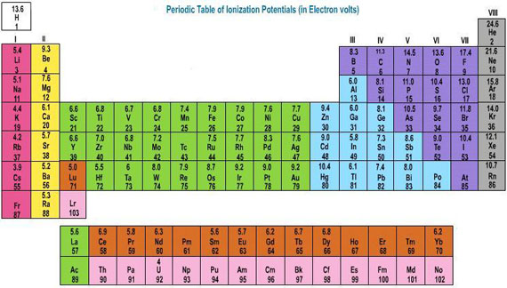
The Periodic Table of Elements

Slide 2
Warm Up November 23 Notebook Page 14
Identify the following information pertaining to the element Nickel:
Number of protons b) Number of electrons
c) Number of neutrons d) Atomic mass
Atomic number f) Symbol
What is the difference between a proton, electron, and a neutron?
Objectives: 8.P.1.1/1.2
-TSWU how elements are organized on the periodic table.
Essential Questions:
How are elements arranged on the periodic table?

Slide 3
Warm Up Notebook Page 13 November 24
Which pair of elements has the MOST similar properties? Explain why…
a) Li and B b) I and Ca
b) K and He d) N and P
2. Which is the best example of a pure substance?
a) peanuts b) milk
c) gold d) air
Objectives: 8.P.1.1/1.2
-TSWU how elements are organized on the periodic table.
Essential Questions:
How are elements arranged on the periodic table?

Slide 4
The Periodic Table of Elements Introduction – Page 14
A table of elements, arranged by atomic number, that shows the patterns in their properties.
The atomic number increases by one as you move from left to right on the periodic table.
The columns are known as groups or families.
The rows are known as periods.

Slide 5
Periods – there are 7 periods on the periodic table.

Slide 6
Groups or families – there are 18 families on the periodic table.
1 2 3 4 5 6 7 8 9 10 11 12 1314 15 16 17 18

Slide 7
The first 18 elements/atoms on the periodic table. Turn to page 20-21D
X | X

Slide 8
Label the first 18 elements/atoms symbols at the top of each box….use your periodic textbook (20-21D).
X | X

Slide 9
Use really small font! Leave plenty of room in each box!
H |  |  |  |  |  |  | He
Li | Be | B | C | N | O | F | Ne
Na | Mg | Al | Si | P | S | Cl | Ar
K X | Ca X

Slide 10
For each atom/element, we will determine its number of protons, neutrons & electrons!
H |  |  |  |  |  |  | He
Li | Be | B | C | N | O | F | Ne
Na | Mg | Al | Si | P | S | Cl | Ar
K | Ca

Slide 11
Below each element abbreviation, indicate the number of protons(p-) electrons(e-) & number of neutrons neutrons (0) in each atom’s nucleus
H P(+)= N(o)= E(-)= |  |  |  |  |  |  | He P(+)= N(o)= E(-)=
Li P(+)= N(o)= E(-)= | Be P(+)= N(o)= E(-)= | B P(+)= N(o)= E(-)= | C P(+)= N(o)= E(-)= | N P(+)= N(o)= E(-)= | O P(+)= N(o)= E(-)= | F P(+)= N(o)= E(-)= | Ne P(+)= N(o)= E(-)=
Na P(+)= N(o)= E(-)= | Mg P(+)= N(o)= E(-)= | Al P(+)= N(o)= E(-)= | Si P(+)= N(o)= E(-)= | P P(+)= N(o)= E(-)= | S P(+)= N(o)= E(-)= | Cl P(+)= N(o)= E(-)= | Ar P(+)= N(o)= E(-)=
K P(+)= N(o)= E(-)= | Ca P(+)= N(o)= E(-)=

Slide 12
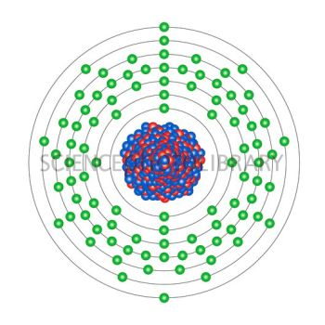
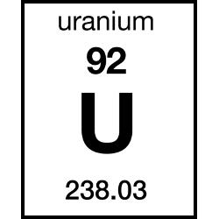
the top number in each Box is called the atomic number —its number of protons(+)

Slide 13
H P(+)= N(o)= |  |  |  |  |  |  | He P(+)= N(o)=
Li P(+)= N(o)= | Be P(+)= N(o)= | B P(+)= N(o)= | C P(+)= N(o)= | N P(+)= N(o)= | O P(+)= N(o)= | F P(+)= N(o)= | Ne P(+)= N(o)=
Na P(+)= N(o)= | Mg P(+)= N(o)= | Al P(+)= N(o)= | Si P(+)= N(o)= | P P(+)= N(o)= | S P(+)= N(o)= | Cl P(+)= N(o)= | Ar P(+)= N(o)=
K P(+)= N(o)= | Ca P(+)= N(o)=
NUMBER OF PROTONS (+) = ATOMIC NUMBER

Slide 14
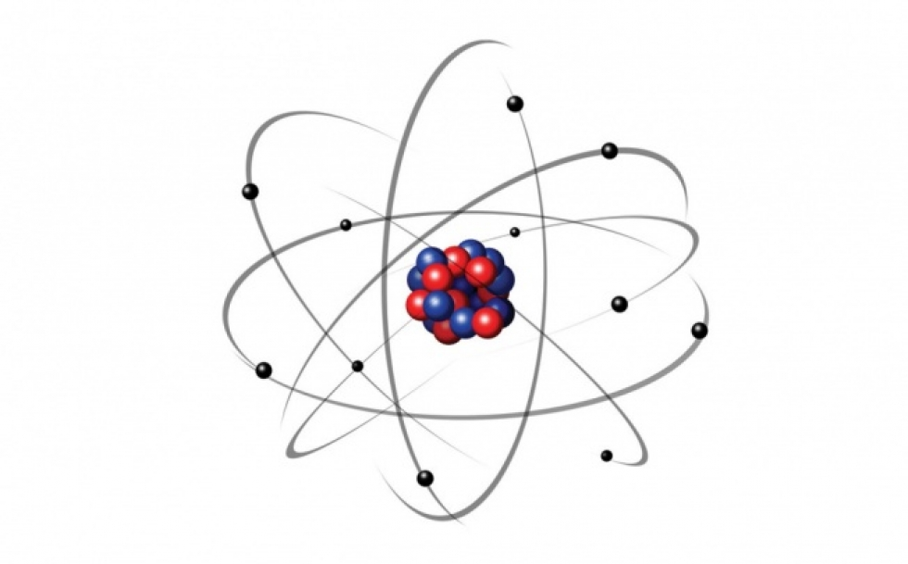
Neutrons (o) have NO CHARGE & keep the protons (+) together in the atomic nucleus.

Slide 15
An atom’s mass is mostly its nucleus (electrons (-) weigh almost nothing).
Electrons (-) are tiniest & weigh almost nothing

Slide 16
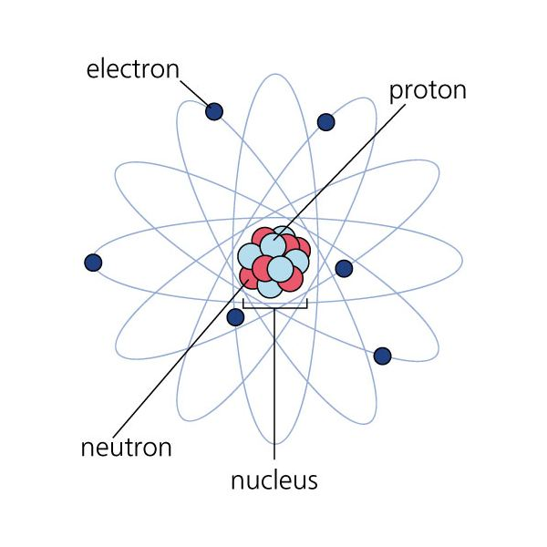
An atom’s mass is mostly its nucleus—of protons (+) & neutrons (o)
Most of its mass HERE.

Slide 17
The atomic mass is mostly protons(+) and neutrons (o), electrons (-) weigh “nothing.”
H P(+)= N(o)= |  |  |  |  |  |  | He P(+)= N(o)=
Li P(+)= N(o)= | Be P(+)= N(o)= | B P(+)= N(o)= | C P(+)= N(o)= | N P(+)= N(o)= | O P(+)= N(o)= | F P(+)= N(o)= | Ne P(+)= N(o)=
Na P(+)= N(o)= | Mg P(+)= N(o)= | Al P(+)= N(o)= | Si P(+)= N(o)= | P P(+)= N(o)= | S P(+)= N(o)= | Cl P(+)= N(o)= | Ar P(+)= N(o)=
K P(+)= N(o)= | Ca P(+)= N(o)=
Number of protons (+) = ATOMIC NUMBER (top #)
NUMBER OF PROTONS(+) & NEUTRONS(o) = ATOMIC MASS

Slide 18
the bottom number in each box is ITS ATOMIC MASS=number of protons(+) AND NEUTRONS (O).

Slide 19
ATOMIC MASS = protons(+) AND NEUTRONS (O).

Slide 20
ATOMIC MASS – ATOMIC NUMBER = ???
H P(+)= N(o)= |  |  |  |  |  |  | He P(+)= N(o)=
Li P(+)= N(o)= | Be P(+)= N(o)= | B P(+)= N(o)= | C P(+)= N(o)= | N P(+)= N(o)= | O P(+)= N(o)= | F P(+)= N(o)= | Ne P(+)= N(o)=
Na P(+)= N(o)= | Mg P(+)= N(o)= | Al P(+)= N(o)= | Si P(+)= N(o)= | P P(+)= N(o)= | S P(+)= N(o)= | Cl P(+)= N(o)= | Ar P(+)= N(o)=
K P(+)= N(o)= | Ca P(+)= N(o)=
Number of protons (+) = ATOMIC NUMBER (top #)
Number of protons (+) & neutrons (o) = ATOMIC MASS (bottom #)
ATOMIC MASS – ATOMIC NUMBER = # of neutrons (o)

Slide 21
What do we get if we subtract the ATOMIC MASS – ATOMIC NUMBER? Number of NEUTRONS (o)!
H P(+)= N(o)= |  |  |  |  |  |  | He P(+)= N(o)=
Li P(+)= N(o)= | Be P(+)= N(o)= | B P(+)= N(o)= | C P(+)= N(o)= | N P(+)= N(o)= | O P(+)= N(o)= | F P(+)= N(o)= | Ne P(+)= N(o)=
Na P(+)= N(o)= | Mg P(+)= N(o)= | Al P(+)= N(o)= | Si P(+)= N(o)= | P P(+)= N(o)= | S P(+)= N(o)= | Cl P(+)= N(o)= | Ar P(+)= N(o)=
K P(+)= N(o)= | Ca P(+)= N(o)=
Number of protons (+) = ATOMIC NUMBER (top #)
Number of protons (+) & neutrons (o) = ATOMIC MASS (bottom #)
ATOMIC MASS – ATOMIC NUMBER = Number of neutrons (o)

Slide 22
Electrons (-) orbit around the nucleus in the electron shell/cloud.
Electrons (-) are tiniest & weigh almost nothing

Slide 23
Electrons (-) have a negative charge
H P(+)= N(o)= |  |  |  |  |  |  | He P(+)= N(o)=
Li P(+)= N(o)= | Be P(+)= N(o)= | B P(+)= N(o)= | C P(+)= N(o)= | N P(+)= N(o)= | O P(+)= N(o)= | F P(+)= N(o)= | Ne P(+)= N(o)=
Na P(+)= N(o)= | Mg P(+)= N(o)= | Al P(+)= N(o)= | Si P(+)= N(o)= | P P(+)= N(o)= | S P(+)= N(o)= | Cl P(+)= N(o)= | Ar P(+)= N(o)=
K P(+)= N(o)= | Ca P(+)= N(o)=
Number of protons (+) = ATOMIC NUMBER (top #)
Number of protons (+) & neutrons (o) = ATOMIC MASS (bottom #)
ATOMIC MASS – ATOMIC NUMBER = Number of neutrons (o)

Slide 24
Each row means another orbit for electrons (-).
H P(+)= N(o)= |  |  |  |  |  |  | He P(+)= N(o)=
Li P(+)= N(o)= | Be P(+)= N(o)= | B P(+)= N(o)= | C P(+)= N(o)= | N P(+)= N(o)= | O P(+)= N(o)= | F P(+)= N(o)= | Ne P(+)= N(o)=
Na P(+)= N(o)= | Mg P(+)= N(o)= | Al P(+)= N(o)= | Si P(+)= N(o)= | P P(+)= N(o)= | S P(+)= N(o)= | Cl P(+)= N(o)= | Ar P(+)= N(o)=
K P(+)= N(o)= | Ca P(+)= N(o)=
THIS 1ST ROW HAS 1 ORBIT OF e(-)
Number of protons (+) = ATOMIC NUMBER (top #)
Number of protons (+) & neutrons (o) = ATOMIC MASS (bottom #)
ATOMIC MASS – ATOMIC NUMBER = Number of neutrons (o)

Slide 25
Each row means another orbit for electrons (-).
H P(+)= N(o)= |  |  |  |  |  |  | He P(+)= N(o)=
Li P(+)= N(o)= | Be P(+)= N(o)= | B P(+)= N(o)= | C P(+)= N(o)= | N P(+)= N(o)= | O P(+)= N(o)= | F P(+)= N(o)= | Ne P(+)= N(o)=
Na P(+)= N(o)= | Mg P(+)= N(o)= | Al P(+)= N(o)= | Si P(+)= N(o)= | P P(+)= N(o)= | S P(+)= N(o)= | Cl P(+)= N(o)= | Ar P(+)= N(o)=
K P(+)= N(o)= | Ca P(+)= N(o)=
THIS 1ST ROW HAS 1 ORBIT OF e(-)
THIS 2ND ROW HAS 2 ORBITS OF e(-)
Number of protons (+) = ATOMIC NUMBER (top #)
Number of protons (+) & neutrons (o) = ATOMIC MASS (bottom #)
ATOMIC MASS – ATOMIC NUMBER = Number of neutrons (o)

Slide 26
Each row means another orbit for electrons (-).
H P(+)= N(o)= |  |  |  |  |  |  | He P(+)= N(o)=
Li P(+)= N(o)= | Be P(+)= N(o)= | B P(+)= N(o)= | C P(+)= N(o)= | N P(+)= N(o)= | O P(+)= N(o)= | F P(+)= N(o)= | Ne P(+)= N(o)=
Na P(+)= N(o)= | Mg P(+)= N(o)= | Al P(+)= N(o)= | Si P(+)= N(o)= | P P(+)= N(o)= | S P(+)= N(o)= | Cl P(+)= N(o)= | Ar P(+)= N(o)=
K P(+)= N(o)= | Ca P(+)= N(o)=
THIS 1ST ROW HAS 1 ORBIT OF e(-)
THIS 2ND ROW HAS 2 ORBITS OF e(-)
THIS 3rd ROW HAS 3 ORBITS OF e(-)
Number of protons (+) = ATOMIC NUMBER (top #)
Number of protons (+) & neutrons (o) = ATOMIC MASS (bottom #)
ATOMIC MASS – ATOMIC NUMBER = Number of neutrons (o)

Slide 27
Normally, electrons (-) equal the number of protons (+) in an atom unless an atom is “charged”.
H P(+)= N(o)= |  |  |  |  |  |  | He P(+)= N(o)=
Li P(+)= N(o)= | Be P(+)= N(o)= | B P(+)= N(o)= | C P(+)= N(o)= | N P(+)= N(o)= | O P(+)= N(o)= | F P(+)= N(o)= | Ne P(+)= N(o)=
Na P(+)= N(o)= | Mg P(+)= N(o)= | Al P(+)= N(o)= | Si P(+)= N(o)= | P P(+)= N(o)= | S P(+)= N(o)= | Cl P(+)= N(o)= | Ar P(+)= N(o)=
K P(+)= N(o)= | Ca P(+)= N(o)=
Number of protons (+) = ATOMIC NUMBER (top #)
Number of protons (+) & neutrons (o) = ATOMIC MASS (bottom #)
ATOMIC MASS – ATOMIC NUMBER = Number of neutrons (o)
Protons (+) = electrons (-)…

Slide 28
As atoms get bigger, electrons (-) find themselves out on further orbits.
H P(+)= N(o)= |  |  |  |  |  |  | He P(+)= N(o)=
Li P(+)= N(o)= | Be P(+)= N(o)= | B P(+)= N(o)= | C P(+)= N(o)= | N P(+)= N(o)= | O P(+)= N(o)= | F P(+)= N(o)= | Ne P(+)= N(o)=
Na P(+)= N(o)= | Mg P(+)= N(o)= | Al P(+)= N(o)= | Si P(+)= N(o)= | P P(+)= N(o)= | S P(+)= N(o)= | Cl P(+)= N(o)= | Ar P(+)= N(o)=
K P(+)= N(o)= | Ca P(+)= N(o)=
THIS 1ST ROW HAS 1 ORBIT OF 2 e(-)
THIS 2ND ROW HAS 2 ORBITS OF 2&8 e(-)
THIS 3rd ROW HAS 3 ORBITS OF 2,8,8 e(-)
Number of protons (+) = ATOMIC NUMBER (top #)
Number of protons (+) & neutrons (o) = ATOMIC MASS (bottom #)
ATOMIC MASS – ATOMIC NUMBER = Number of neutrons (o)
Protons (+) = electrons (-)…2 fit in 1st orbit, 8 in 2nd orbit, 8 in 3rd orbit

Slide 29
As atoms get bigger, electrons (-) find themselves out on further orbits.
H P(+)= N(o)= |  |  |  |  |  |  | He P(+)= N(o)=
Li P(+)= N(o)= | Be P(+)= N(o)= | B P(+)= N(o)= | C P(+)= N(o)= | N P(+)= N(o)= | O P(+)= N(o)= | F P(+)= N(o)= | Ne P(+)= N(o)=
Na P(+)= N(o)= | Mg P(+)= N(o)= | Al P(+)= N(o)= | Si P(+)= N(o)= | P P(+)= N(o)= | S P(+)= N(o)= | Cl P(+)= N(o)= | Ar P(+)= N(o)=
K P(+)= N(o)= | Ca P(+)= N(o)=
draw 1 orbit…
draw 2 orbits…
draw 3 orbits…
Number of protons (+) = ATOMIC NUMBER (top #)
Number of protons (+) & neutrons (o) = ATOMIC MASS (bottom #)
ATOMIC MASS – ATOMIC NUMBER = Number of neutrons (o)
Protons (+) = electrons (-)…2 fit in 1st orbit, 8 in 2nd orbit, 8 in 3rd orbit

Slide 30
For each element, draw the electrons on each orbit for each atom.
H P(+)= N(o)= |  |  |  |  |  |  | He P(+)= N(o)=
Li P(+)= N(o)= | Be P(+)= N(o)= | B P(+)= N(o)= | C P(+)= N(o)= | N P(+)= N(o)= | O P(+)= N(o)= | F P(+)= N(o)= | Ne P(+)= N(o)=
Na P(+)= N(o)= | Mg P(+)= N(o)= | Al P(+)= N(o)= | Si P(+)= N(o)= | P P(+)= N(o)= | S P(+)= N(o)= | Cl P(+)= N(o)= | Ar P(+)= N(o)=
K P(+)= N(o)= | Ca P(+)= N(o)=
THIS 1ST ROW HAS 1 ORBIT OF 2 e(-)
THIS 2ND ROW HAS 2 ORBITS OF 2&8 e(-)
THIS 3rd ROW HAS 3 ORBITS OF 2,8,8 e(-)
Number of protons (+) = ATOMIC NUMBER
Number of protons (+) & neutrons (o) = ATOMIC MASS
ATOMIC MASS – ATOMIC NUMBER = Number of neutrons (o)
Protons (+) = electrons (-)

Slide 31
Grab an atom kit and get into your groups of 4

Slide 32
Let’s see each group make a model of the first 20 elements!

Slide 33
HYDROGEN…

Slide 34
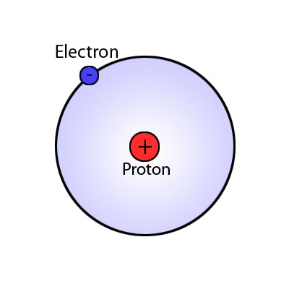
HYDROGEN…

Slide 35
HELIUM…

Slide 36
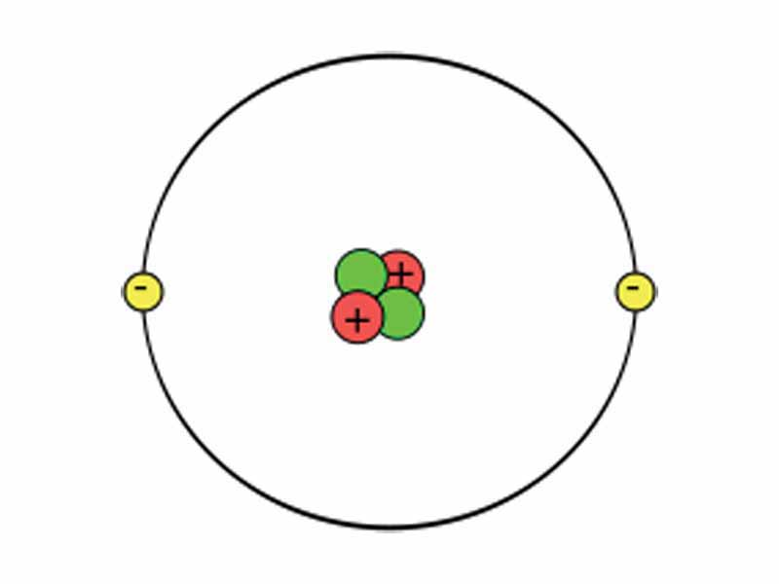
HELIUM…

Slide 37
LITHIUM…

Slide 38
BERYLLIUM…

Slide 39
BORON…

Slide 40
CARBON…

Slide 41
NITROGEN…

Slide 42
OXYGEN…

Slide 43
FLUORINE…

Slide 44
NEON…

Slide 45
SODIUM…

Slide 46
MAGNESIUM…

Slide 47
ALUMINUM…

Slide 48
SILICON…

Slide 49
PHOSPHORUS…

Slide 50
SULFUR…

Slide 51
CHLORINE…

Slide 52
ARGON…

Slide 53
POTASSIUM…

Slide 54
CALCIUM…

Slide 55
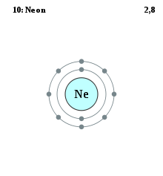
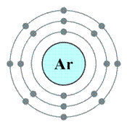
The number of electrons in the last shell of an atom are known as valence electrons.
Discussion Questions:
1- How many valence electrons does argon have?
2- How many valence electrons does neon have?

