Slide 1
Cell Cycles: Mitosis and Meiosis
Notebook Page 12

Slide 2
Warm Up & Spiral 2/23/2017
What is the chemical formula for glucose?
How many hydrogen atoms are in glucose?
What is protein synthesis?
OBJECTIVES: 8.L.5.1
-TSWU that cells carry on the many functions needed to support life including cell respiration, photosynthesis, protein synthesis, mitosis, and meiosis.
Essential Question:
-What are the 4 phases of mitosis?

Slide 3
Warm Up Page 13 2/22/2016
What does the cell do with the energy produced by cellular respiration?
What is the difference between mitosis and meiosis?
Which cell organelle controls ALL cell activity and stores heredity information?
OBJECTIVES: 8.L.5.1
-TSWU that cells carry on the many functions needed to support life including cell respiration, photosynthesis, protein synthesis, mitosis, and meiosis.
Essential Question:
-What are the 4 phases of mitosis?

Slide 4
Discussion Question: What do cells do with all the energy created from cellular respiration?

Slide 5
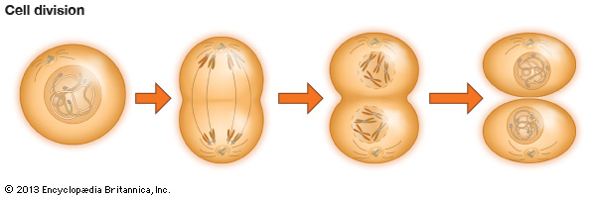
But some energy is used for cell reproduction.
Most energy is used for basic life functions including; breathing, blinking, heart beating.
10% of the energy is used for the digestion of food.
20% is used for daily physical activity.

Slide 6
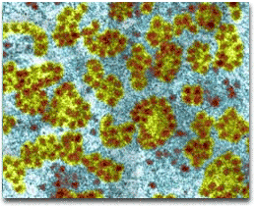
Cells use RIBOSOMES to grow new cell parts (organelles).
Each of your
cells have thousands
of ribosome factories.
The use proteins.

Slide 7
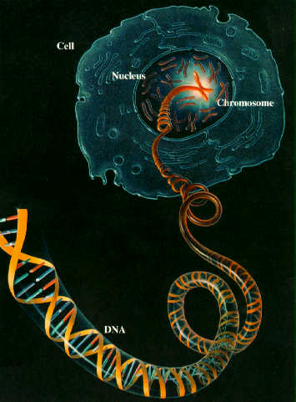
Ribosomes follow your DNA instructions stored in the cell nucleus.

Slide 8
The process is called…
PROTEIN SYNTHESIS

Slide 9
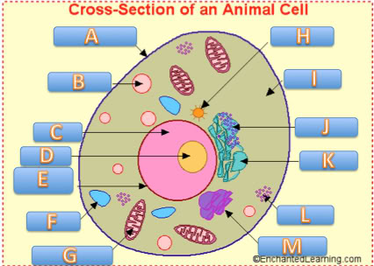
DQ? What does a cell do with all these new organelles??
Can you name the organelles on the left?

Slide 10
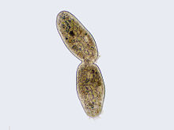
When ribosomes make twice as much organelles as a cell needs, the cell splits in 2! It reproduces asexually.

Slide 11
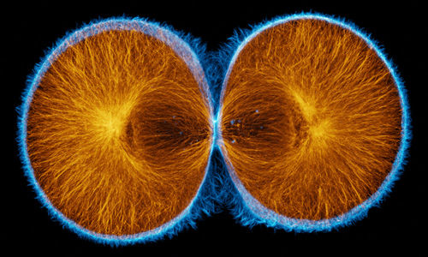
When ribosomes make twice as much organelles as a cell needs, the cell splits in 2! It reproduces asexually.

Slide 12
This final stage where a cell splits in 2 is called CYTOKINESIS!

Slide 13
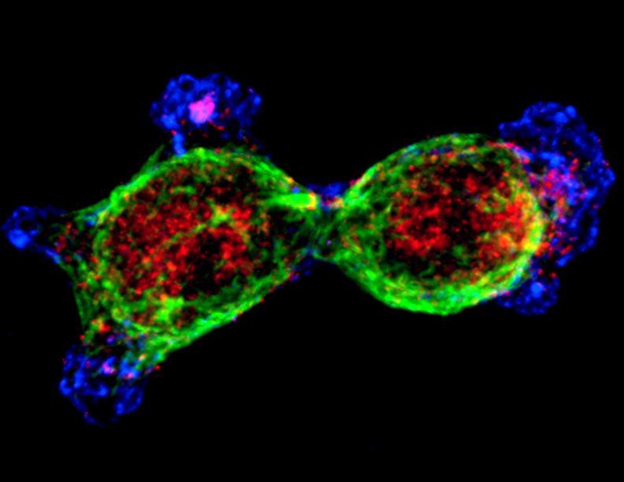
This final stage where a cell splits in 2 is called CYTOKINESIS!

Slide 14
DQ: Why does the cell nucleus need to split before the rest of the cell can?

Slide 15
Why does the cell nucleus need to split before the rest of the cell can?
Because the cell nucleus contains your sensitive DNA instructions on how to build YOU!

Slide 16
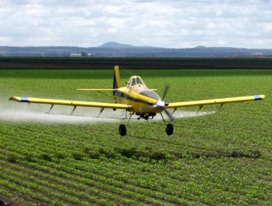
That’s why we need to stay away from MUTAGENS!
Mutagens are harmful chemicals, radiation, even viruses that can enter our cell nucleus and cause our DNA genetic material to change.

Slide 17
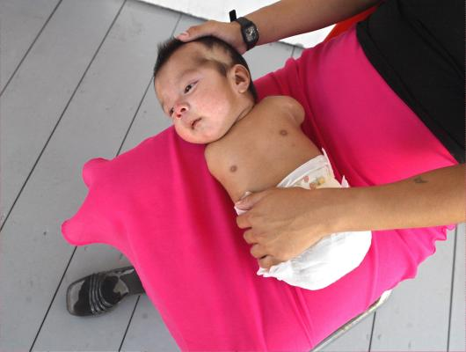
That’s why we need to stay away from MUTAGENS!
Mutagens are harmful chemicals, radiation, even viruses that can enter our cell nucleus and cause our DNA genetic material to change.

Slide 18
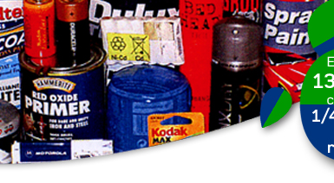
That’s why we need to stay away from MUTAGENS!
Mutagens are harmful chemicals, radiation, even viruses that can enter our cell nucleus and cause our DNA genetic material to change.

Slide 19
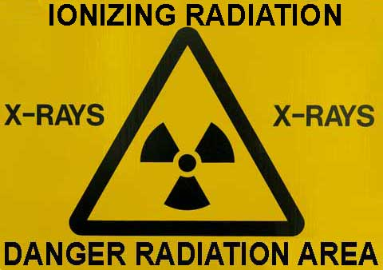
That’s why we need to stay away from MUTAGENS!
Mutagens are harmful chemicals, radiation, even viruses that can enter our cell nucleus and cause our DNA genetic material to change.

Slide 20
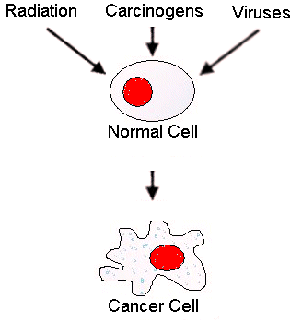
That’s why we need to stay away from MUTAGENS!
Mutagens are harmful chemicals, radiation, even viruses that can enter our cell nucleus and cause our DNA genetic material to change.

Slide 21
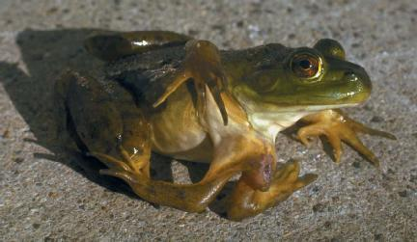
That’s why we need to stay away from MUTAGENS!
Mutagens are harmful chemicals, radiation, even viruses that can enter our cell nucleus and cause our DNA genetic material to change.

Slide 22
So, a cell nucleus must split very carefully to ensure no mutations occur!

Slide 23
So first, a cell nucleus must split very carefully to ensure no mutations occur!
This process is called MITOSIS!

Slide 24
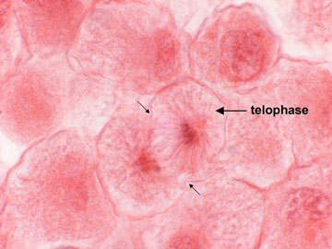
A cell nucleus must split very carefully
This process is called MITOSIS!

Slide 26
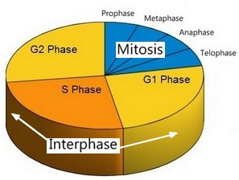
MITOSIS in the cell nucleus happens in 4 stages.

Slide 27
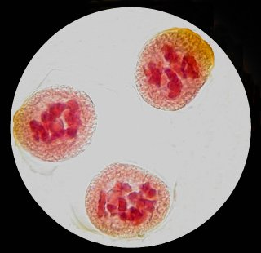
MITOSIS in the cell nucleus happens in 4 stages.
#1…DNA bundles into chromosomes.
This is the “prophase.”

Slide 28
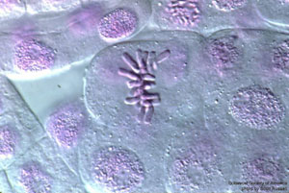
MITOSIS in the cell nucleus happens in 4 stages.
#2…Chromosomes line up in the middle of the nucleus.
This is the “metaphase.”

Slide 29
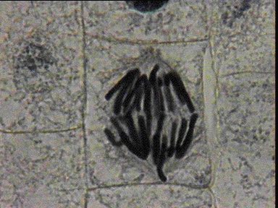
MITOSIS in the cell nucleus happens in 4 stages.
#3…Chromosomes carefully split apart.
This is the “anaphase.”

Slide 30
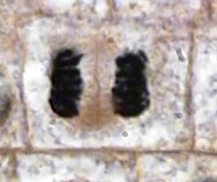
MITOSIS in the cell nucleus happens in 4 stages.
#4…The cell nucleus splits in two.
This is the “telophase.”

Slide 31
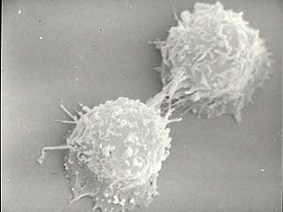
Only after mitosis can the entire cell successfully divide!
This is
known as CYTOKINESIS!
When the cell membrane finally pinches into two parts.

Slide 33
Mitosis Graphic Organizer

Slide 34
Discovery Education BoardBuilder
Log on to www.discoveryeducation.com
Create a board builder under builder tools
Include 1 title slide with the title, “Cell Division” names, date, and block.
Create 4 informative slides
interphase, 4 steps to mitosis, cytokinesis, and How is meisosis different?
4-5 facts per slide
Create 1 picture slide with a picture and a caption
Create 1 video slide with a summary and a 1-3 minute video clip
Share with me : )

Slide 35
Mitosis Reflection: On the back of the graphic organizer.
The cell spends most of its time in which stage of the cell cycle? Describe this phase…
What is mitosis?
In which phase does a cell’s membrane disappear?
What happens to the chromosomes during anaphase?
What happens to a cell after cytokinesis?
Which process results from an increase in the number of cells that make up an organisms? a) growth b) reproduction c) respiration d) digestions

Slide 36
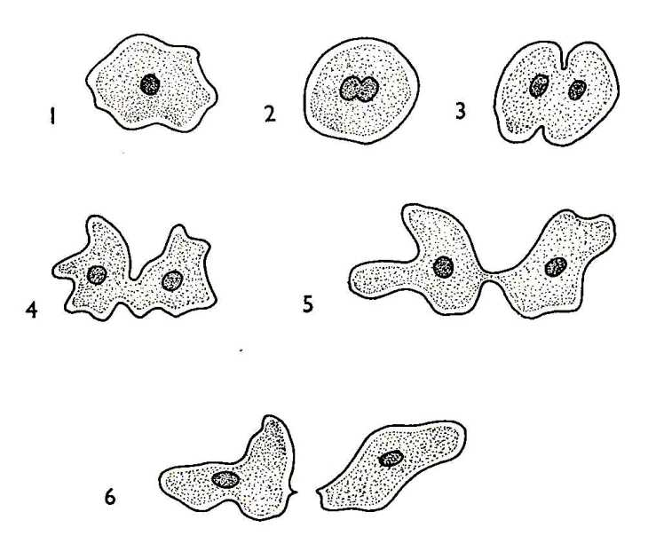
MITOSIS
MEIOSIS
For everyday growth & repair of tissues.
Cells split into two perfectly cloned copies!
ASEXUAL reproduction
How is meiosis different from mitosis?

Slide 37
MITOSIS
MEIOSIS
For everyday growth & repair of tissues.
Cells split into two perfectly cloned copies!
ASEXUAL reproduction
All eukaryotic organisms
Deals with the division of sex cells.
Mainly occurs in eukaryotic cells.
Also known as eukaryotes.
Sexual reproduction
Sperm and egg

Slide 38
What do cells do with all the energy created from cellular respiration?
Why does the cell nucleus need to split before the rest of the cell can?
What is cellular respiration?
Which organelle is mostly responsible for cellular respiration?
What is protein synthesis?
Which organelles are responsible for protein synthesis?
Name and briefly describe the four phases of mitosis.
Create a t-chart or Venn diagram and compare and contrast Mitosis to Meiosis.

Slide 39
Discovery Education: Board Builder: Mitosis Discussion Questions
What do cells do with all the energy created from cellular respiration?
Why does the cell nucleus need to split before the rest of the cell can?
What is cellular respiration?
Which organelle is mostly responsible for cellular respiration?
What is protein synthesis?
Which organelles are responsible for protein synthesis?
Name and briefly describe the four phases of mitosis.
Create a t-chart or Venn diagram and compare and contrast Mitosis to Meiosis.
What is the difference between mitosis and meiosis?
Which process results from an increase in the number of cells that make up an organism?

