Slide 1
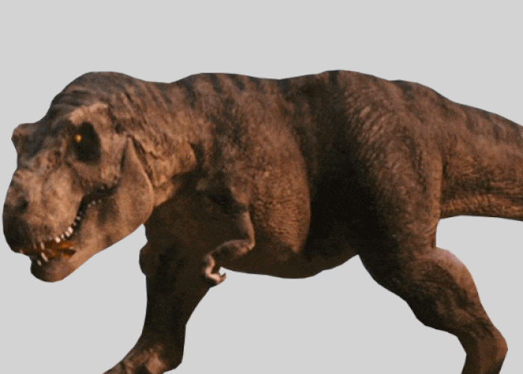
Evolution Writing Prompt

Slide 2
Evolution Writing Prompts
Choose ONE of the following topics and write a 3 paragraph essay to compare and contrast the evolution of earth to either the evolution of dance or technology. Make sure you answer ALL of the bullets for that article. Be sure to provide a short introduction and conclusion to your essay. Be sure to use information from the video clips as well as information from our class discussion when writing your essay. Use this PowerPoint to guide you.
Evolution of Dance
Explain how each of the dancing styles have evolved over time. (movement, music, clothing). Explain why each these dance styles may have been popular during their time.
Explain why these types of dance styles may have been replaced with new styles of dance.
Evolution of Technology
Explain how technology has evolved over time (from your childhood, your parents childhood, maybe even your grandparents childhood). Explain how each of you may have had to adapt to changes with technology.
Some questions you might want to answer include but are not limited to: What are some ways technology has changed education? How has communication changed? How has travel become easier?

Slide 3
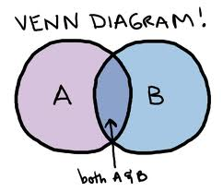
Literacy Activity
Go to You Tube and watch a video on either (choose)…
Evolution of Dance or
Evolution of technology
Create a Venn Diagram (choose)
Compare and contrast the
evolution of EARTH to the evolution
of DANCE OR TECHNOLOGY
Comparison Essay
Write a 3 paragraph essay comparing and contrasting the evolution of dance or technology to the evolution of the Earth.
Each paragraph must be a minimum of 5-8 sentences each.
You must include an introduction paragraph, a body, and a conclusion.
Do your best to compare and contrast the concepts.
Include terms we learned in class such as evolution, change, uniformitarianism etcetera.

Slide 4
Evolution Venn Diagram
Evolution of Earth
Evolution of
dance or tech
Both
1. ------------------------
2. ------------------------
3. ------------------------
4. ------------------------
5. ------------------------
6. ------------------------
7. ------------------------
8. ------------------------
PICTURE
1. ------------------------
2. ------------------------
3. ------------------------
4. ------------------------
5. ------------------------
6. ------------------------
7. ------------------------
8. ------------------------
PICTURE
1. --------------
2. --------------
3. --------------
4. --------------
5. --------------
6. --------------

