Slide 1
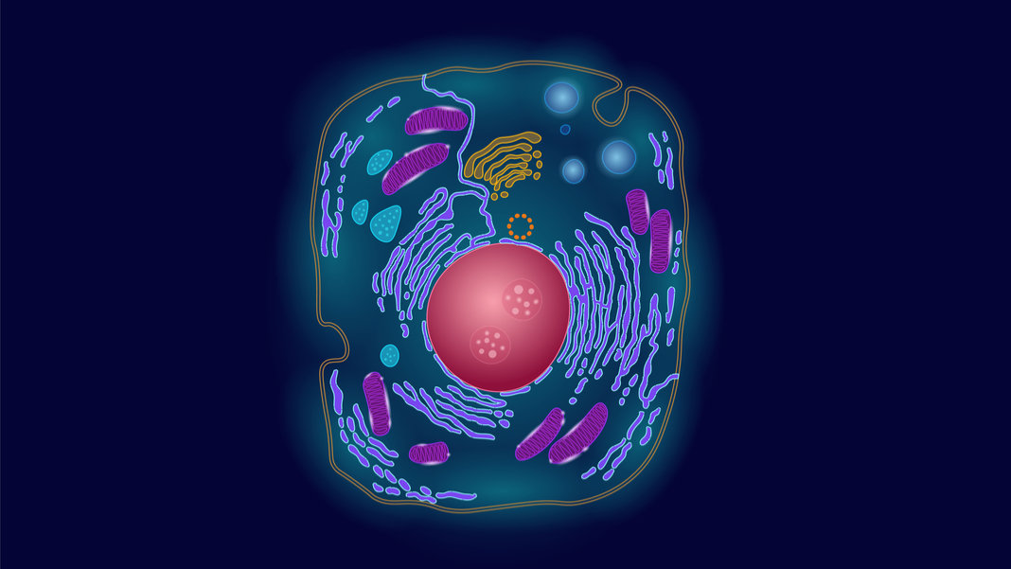
Cell Activity
Color, label, and Review

Slide 2
CELL PROJECT PACKETS KEY
purple
Darker blue
black
red
light blue
yellow
purple
darker blue
yellow
red
light blue
darker green
black
light green
Light green

Slide 3
Page 1

Slide 4
Page 2

Slide 5
Page 3:
Use the next slide to correctly match the organelle descriptions and how I can remember for each organelle.

Slide 6
Page 3

Slide 7
Page 4

