Slide 1
---BACTERIA--- Notebook Page 19

Slide 2
Warm Up 2/5/2013
Why are bacteria considered extremophiles?
Describe 2 environments bacteria can survive in which other organisms cannot.
Objectives: 8.L.1.1
-TSW understand the basic characteristics of bacteria and viruses.
Essential Questions:
-How do bacteria multiply?
-What are the basic characteristics of a virus?

Slide 3
Warm Up Hough Trip 3/6/2017
Directions: Write and answer the following questions in your notebook.
Answer the following questions from your test:
1. Which process results from an increase in the number of cells that make up an organism?
a) growth b) reproduction c) respiration d) digestion
2. Which process do animals use to make reproductive cells?
a) cell respiration b) mitosis c) meiosis d) protein synthesis
Objectives: 8.L.5.1 and 8.L.1.1
-TSW review the Unit 1E Assessment.
-TSW understand the structure and characteristics of bacteria.
Essential Question:
-What are the basic characteristics of bacteria and where can they be found?

Slide 4
Warm Up 3/1/2016
Directions: Write and answer the following questions in your notebook.
Answer the following questions on your test:
1. What is a mutagen and provide one example.
2. Which organelle is responsible for cellular respiration?
3. Which organelles are responsible for protein synthesis?
Objectives: 8.L.5.1 and 8.L.1.1
-TSW review the Unit 1E Assessment.
-TSW understand the structure and characteristics of bacteria.
Essential Question:
-What are the basic characteristics of bacteria and where can they be found?

Slide 5
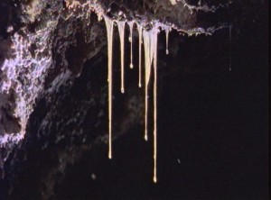
Warm Up March 7, 2017
Directions: Read passage 1 then answer the 3 questions below. Underline or highlight the text where you found your answer. Glue the passage into your notebook.
Which statement best describes snottites?
Based on this passage, which conclusion about snottites is most likely to be correct?
What is the main idea of this passage?
Objectives: 8.L.1.1
-TSWU the basic characteristics and structure of bacteria.
Essential Question:
-How are bacteria capable of surviving extreme conditions?

Slide 6
Warm Up 3/8/2017
What is the difference between a prokaryotic organism and a eukaryotic organism?
Name one example of a prokaryote and one example of a eukaryote.
Objectives: 8.L.1.1
-TSW understand the basic characteristics and structures of bacteria.
Essential Questions:
-Why are bacteria so versatile?
-How do bacteria reproduce?

Slide 7
DISCUSSION POINTS Cooperative Group Discussion
1. What are microorganisms?
2. Is it possible for microorganisms to be good and bad? Explain…

Slide 8
Cooperative Group Reflection Life Science: Bacteria (20:00)
Describe three ways in which bacteria is helpful.
Describe three ways in which bacteria can be harmful.
What drugs are used to kill bacteria?
What problems are associated with overprescribing drugs to kill bacteria in our bodies?
Name at least three places bacteria can live where other living things can’t.
----------------------------Definitions:------------------------------
Extremophiles
Antibiotic
MOVED TO MIDDLE OF NOTES

Slide 9
What is the smallest living thing?
What is the smallest unit of all living things?

Slide 10
Bacteria
the smallest living thing

Slide 11
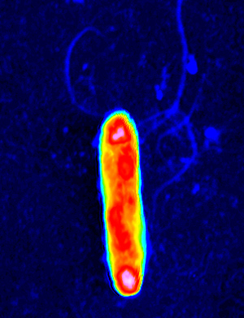
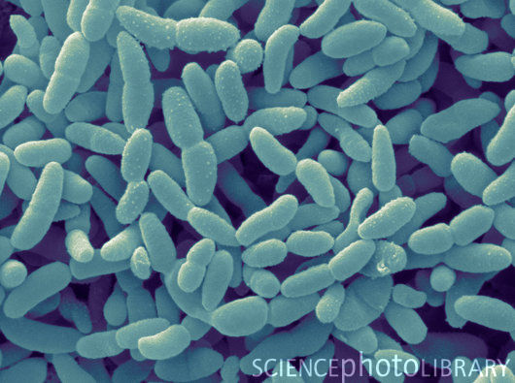
Single one = bacterium
Many = bacteria

Slide 12
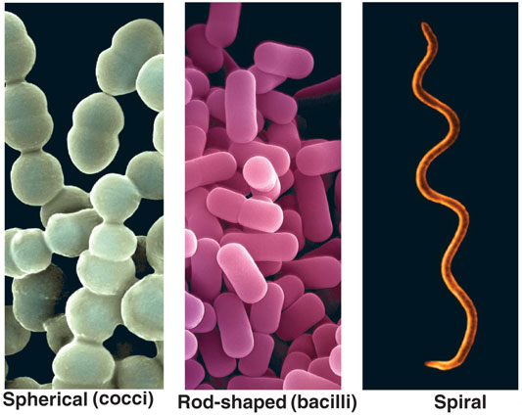
Earth has millions of types of bacteria!
Bacteria typically come in 3 shapes:

Slide 13
Bacteria are single-celled organisms that are smaller than our body’s cells.
UNICELLULAR
How much smaller?
Check out an e.coli bacterium versus our red blood cell.
http://learn.genetics.utah.edu/content/begin/cells/scale

Slide 14
Bacteria are the most primitive life on our planet…
.
They’ve existed on Earth for BILLIONS of years!

Slide 15
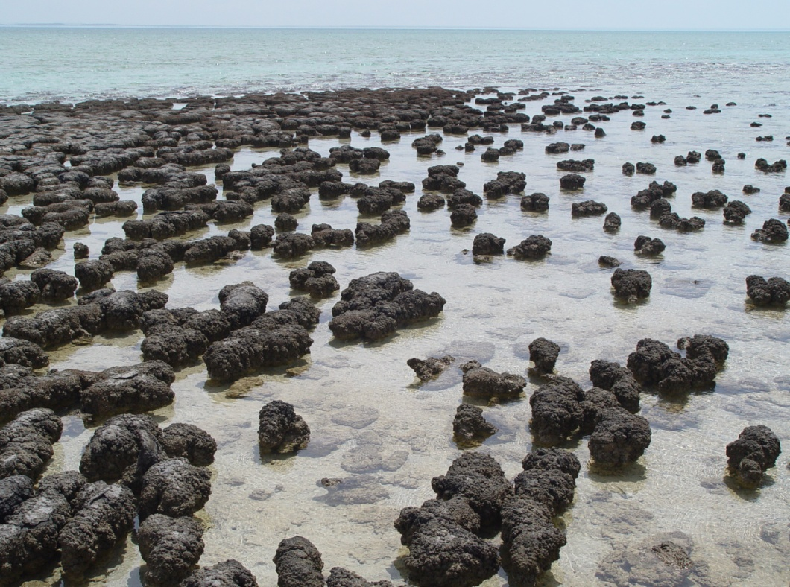
Fossils
Stromatolites are structures created by photosynthetic bacteria (prokaryotes). These rounded, bulbous shapes are usually less than 1 meter across and contain fine layering.
Photosynthetic bacteria live on thin mats in shallow water. As they become covered in clay and particles, these bacteria move upwards toward the light they require. This movement leaves behind dead layers, much in the same way that trees leave behind inner wood as they grow. Stromatolites are recognizable because of the “tree ring” structure that records the movement of bacteria.
The earliest known fossils of stromatolites are dated at 3.45 Ga, and come from Western Australia. Ironically, the highly-saline bays of Western Australia are one of the few places in the world today where living stromatolites exist.
http://www.youtube.com/watch?v=DvZBjt_O58I

Slide 16
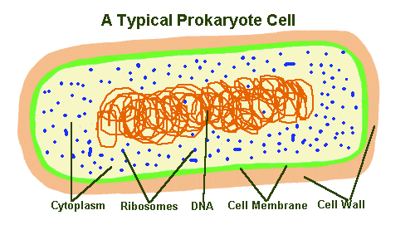
Bacteria are so primitive that they don’t have a nucleus.
A bacterium’s DNA just floats around the cytoplasm.

Slide 17
A BACTERIUM CELL with no nucleus is known as PROKARYOTIC
A bacterium’s DNA just floats loosely around the cytoplasm.

Slide 18
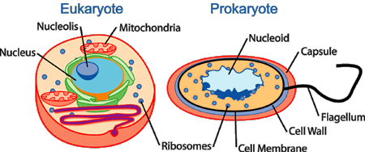
We & other complex plants & animals have nuclei to protect our intricate DNA!
Advanced complex life = eukaryotic cells
Primitive simple life = prokaryotic cells

Slide 19
Bacteria never developed, they stayed simple.
Advanced complex life = eukaryotic cells
Primitive simple life = prokaryotic cells

Slide 20
Cooperative Group Reflection Life Science: Bacteria (20:00)
Describe three ways in which bacteria is helpful.
Describe three ways in which bacteria can be harmful.
What drugs are used to kill bacteria?
What problems are associated with overprescribing drugs to kill bacteria in our bodies?
Name at least three places bacteria can live where other living things can’t.
----------------------------Definitions:------------------------------
Extremophiles
Antibiotic

Slide 21
Bacteria are so simple, they can live in extreme conditions.

Slide 22
How extreme?

Slide 23
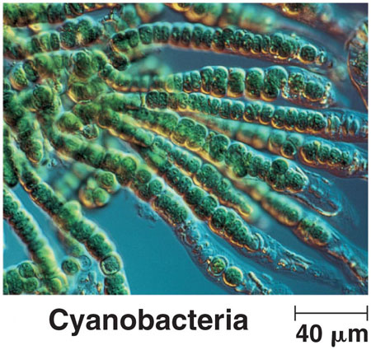
Cyanobacteria live in all types of water conditions--polluted & otherwise.

Slide 24
Cyanobacteria live in all types of water conditions--polluted & otherwise.
They are the smallest phytoplankton.

Slide 25
Snottite bacteria in total darkness in acid caves…
They are found hanging from the walls and ceilings of toxic sulphur caves (most notably Cueva de Villa Luz in Tabasco, Mexico).

Slide 26
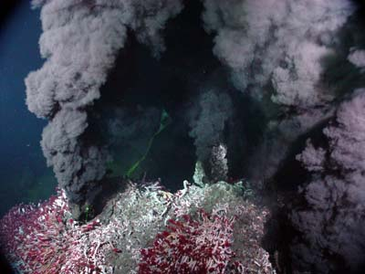
Chemosynthetic bacteria live under great ocean pressure in toxic gas!
Recently discovered in 1977, hydrothermal vents, also known as "black smokers", revolutionized our understanding of life. Until the discovery of these vent systems, all known ecosystems on Earth had photosynthetic organisms at the base of their food chain.
However, this particular type of ecosystem is dependent on chemosynthetic bacteria that generate energy from hydrogen sulfide, the chemical responsible for the smell of rotten eggs.
These chemotrophic (chemical eating) bacteria exist in symbiotic relationships with other members of the ecosystem including mussels and 8 foot long tubeworms.

Slide 27
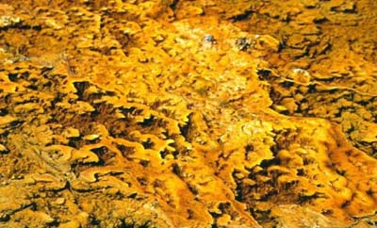
These yellow bacteria live in boiling hot chemical soups!
This vast bacterial mat is found in regions around hot springs such as the Grand Prismatic Springs. There are more bacteria alive in one inch of this bacterial mat than there are humans in existence.

Slide 28
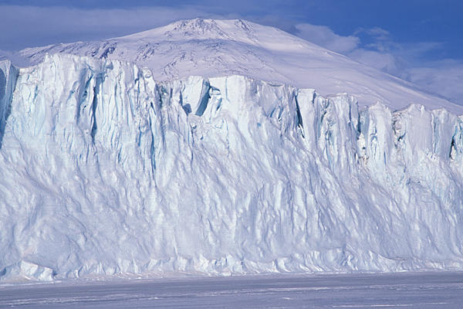
Ancient bacteria living in frozen glaciers!
The coldest temperature recorded on Earth was recorded at Vostok Station in Russia. With the help of radar, in 1996, a vast sub-glacial lake was discovered nearby.
The ice core samples have proven valuable, and have resulted in the discovery of new bacteria that are 400,000 years old.

Slide 29
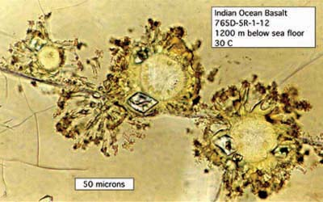
Bacteria living inside the rock. (not just the cracks, nope, that’s too easy.)
These bacteria are exciting to astrobiologists because if life were to exist on Mars, it would have to be in the subsurface, with no access to light or oxygen. The types of rocks that support these rock eaters on Earth are also found on Mars. Mars!?

Slide 30
More extremes…
http://www.calacademy.org/exhibits/xtremelife/life_on_earth.php
Explore More
1. What characteristics do you feel are essential to consider something alive?
2. How does a “snottite” differ from organisms you are more familiar with?
3. What do snottites use as an energy source? How is this connected to the environment they live in?

Slide 31
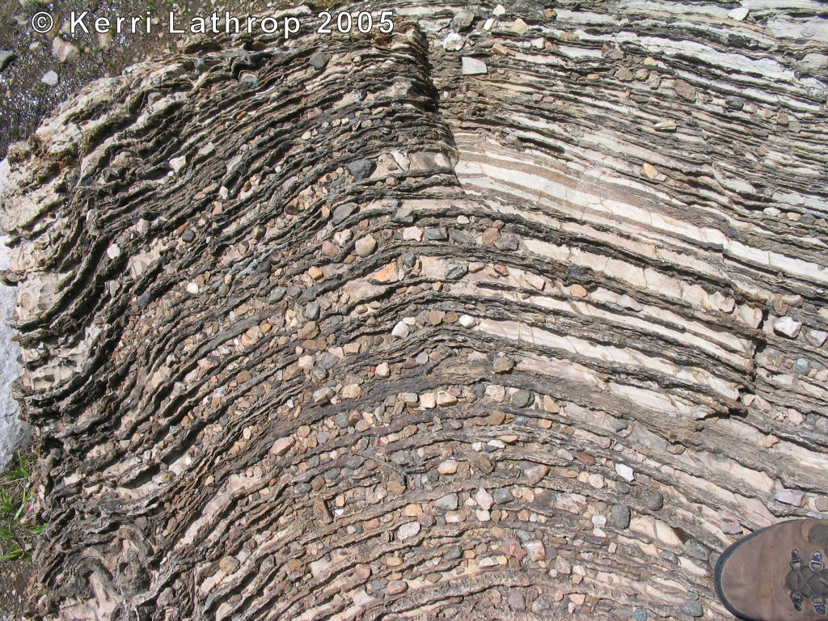
Bacteria ARE hearty living things!
HOW DO WE KNOW?

Slide 32
Bacteria very tough living things!
HOW DO WE KNOW?
1. THEY’VE BEEN AROUND 3.5 BILLION YEARS!
2.
http://www.calacademy.org/exhibits/xtremelife/life_on_earth.php

Slide 33
Bacteria can live in extreme conditions.
No air, burned by acids, squeezed under pressure, boiled in chemicals, frozen in ice, even INSIDE ROCK!

Slide 34
Bacteria are very tough living things!
HOW DO WE KNOW?
1. THEY’VE BEEN AROUND 3.5 BILLION YEARS!
2. THEY CAN LIVE IN EXTREME CONDITIONS!
WHY ARE THEY SO resilient?

Slide 35
Why do you think “simple” prokaryotic bacteria are so successful at survival?
discussion point

Slide 36
What’s easier to maintain?

Slide 37
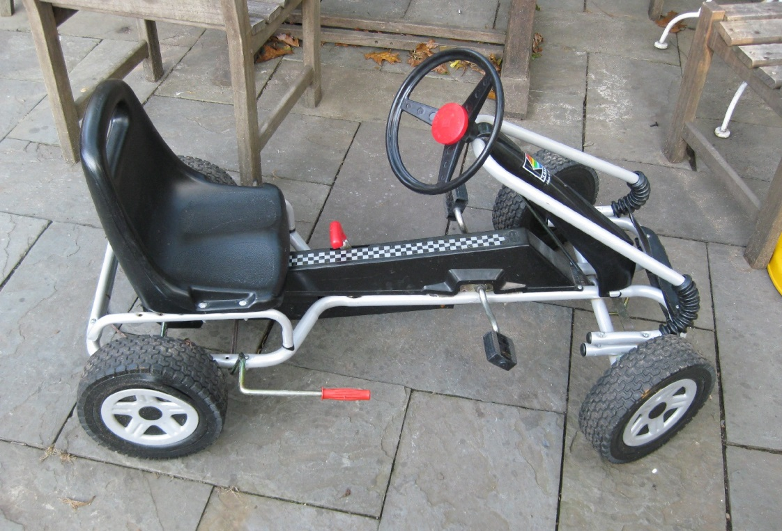
What’s easier to maintain?
Pedal car?

Slide 38
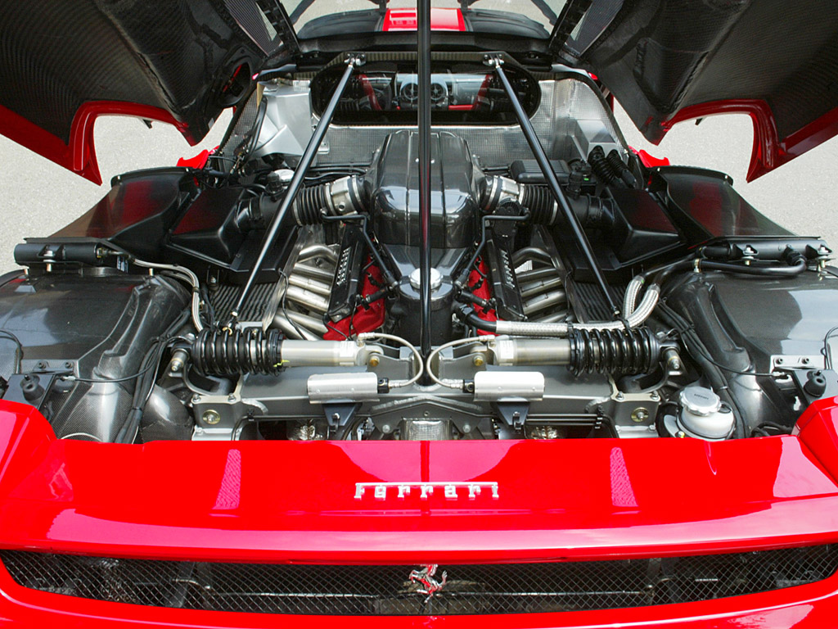
What’s easier to maintain?
Pedal car?
Ferrari Enzo?

Slide 39
What survives a fall?

Slide 40
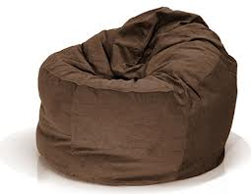
What survives a fall?
A beanbag chair?

Slide 41
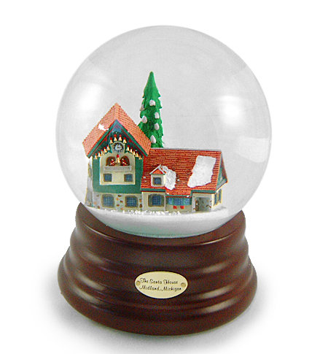
What survives a fall?
A beanbag chair?
A snowglobe?

Slide 42
Bacteria ARE tough living things!
HOW DO WE KNOW?
1. THEY’VE BEEN AROUND 3.5 BILLION YEARS!
2. THEY CAN LIVE IN EXTREME CONDITIONS!
WHY ARE THEY SO REILIENT?
1.
2.

Slide 43
Bacteria ARE tough living things!
HOW DO WE KNOW?
1. THEY’VE BEEN AROUND 3.5 BILLION YEARS!
2. THEY CAN LIVE IN EXTREME CONDITIONS!
WHY ARE THEY SO REILIENT?
1. THEY ARE VERY SMALL, SIMPLE CREATURES.
2.

Slide 44
But what bacteria lack in size…

Slide 45
But what bacteria lack in size… they make up in REPRODUCTION!

Slide 46
Bacteria ARE versitile living things!
HOW DO WE KNOW?
1. THEY’VE BEEN AROUND 3.5 BILLION YEARS!
2. THEY CAN LIVE IN EXTREME CONDITIONS!
WHY ARE THEY SO tough?
1. THEY ARE VERY SMALL, SIMPLE CREATURES.
2. THEY CAN REPRODUCE LIKE CRAZY!
http://www.youtube.com/watch?v=gEwzDydciWc

Slide 47
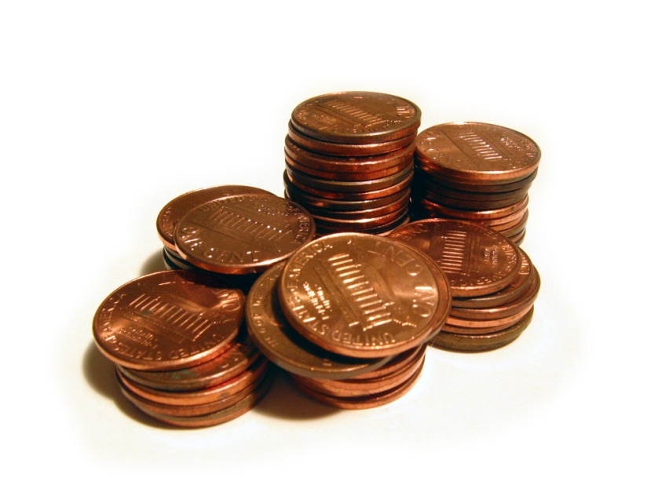
Ace Reward Which one would you choose?
Mr. Black give you $100.00 every day for 30 days?
-----------------------OR---------------------------
2. Mr. Black give you .01 cent and double it every day for 30 days?

Slide 48
Ace Reward Which one would you choose?
Mr. Black give you $100.00 every day for 30 days? $3,000
-----------------------OR---------------------------
2. Mr. Black give you .01 cent and double it every day for 30 days? $10,737,418.24

Slide 49
---hand-out graph paper do table at bottom---
Time passed | # of bacteria
BEGIN | 10
:20
:40
1 HOUR
1:20
1:40
2 HRS
2:20
2:40
3 HRS
3:20
3:40
4 HRS
4:20
4:40
5 HRS
5:20
5:40

Slide 50
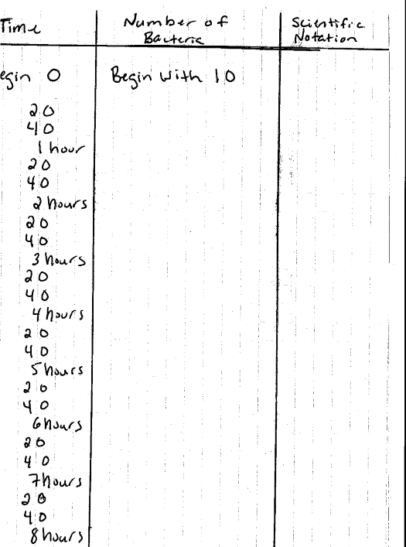
Objective: Model the reproductive process of
Bacteria known as Binary Fission
HINTS
-Title each column.
-Remember, to find the scientific notation for each use the following formula:
a X 10
n
a must be between
1-10
-Example: 160 written in scientific notation is
1 6 0
1.6 x 10
2

Slide 51
Label your graph…
Numb
e
r
of
b
a
c
t
e
r
i
a
Time: every 20 minutes: 0-8 hours

Slide 52
Bacteria can split in 2 in as little as every 20 minutes!!!
Numb
e
r
of
b
a
c
t
e
r
i
a
1.1M
900K
700K
500K
300K
100K
1hr
2hrs
3hrs
4hrs
5 hrs
Time: every 20 minutes: 0-8 hours

Slide 53
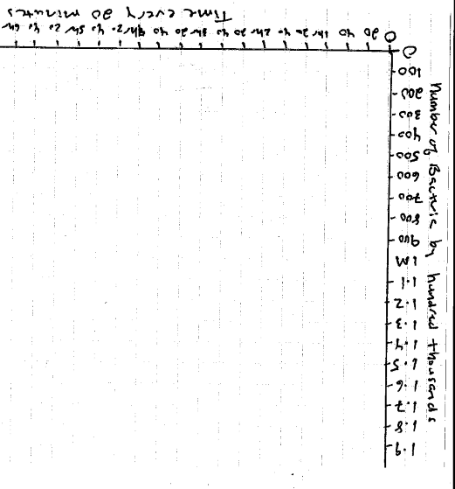
HINTS
-Where the X and Y axis meet should be labeled 0
-Plot your points then connect your dots.

Slide 54
And let’s say you inhale 10 deadly bacteria in your lungs.
Numb
e
r
of
b
a
c
t
e
r
i
a
1.1M
900K
700K
500K
300K
That’s not much..
100K
1hr
2hrs
3hrs
4hrs
5 hrs
Time: every 20 minutes

Slide 55
After 5 hrs 40 minutes, your 655,360 wee tiny deadly bacteria double to 1,310,720 bacteria.
yikes
Numb
e
r
of
b
a
c
t
e
r
i
a
1.1M
900K
700K
500K
300K
100K
1hr
2hrs
3hrs
4hrs
5 hrs
Time: every 20 minutes

Slide 56
Time passed | # of bacteria
BEGIN | 10
:20 | 20
:40 | 40
1 HOUR | 80
1:20 | 160
1:40 | 320
2 HRS | 640
2:20 | 1,280
2:40 | 2,560
3 HRS | 5,120
3:20 | 10,240
3:40 | 20,480
4 HRS | 40,960
4:20 | 81,920
4:40 | 163,840
5 HRS | 327,680
5:20 | 655,360
5:40 | 1,310,720

Slide 57
In less than 6 hours your 10 wee tiny deadly bacteria have grown to 1,310,720 bacteria.
yikes
Numb
e
r
of
b
a
c
t
e
r
i
a
1.1M
900K
700K
500K
300K
100K
1hr
2hrs
3hrs
4hrs
5 hrs
Time: every 20 minutes

Slide 58
---Growth of Bacteria Reflection---
Suppose a single bacterium divided every hour for 20 hours. How many bacterium will there be?
How many bacteria exist after 8 hours if you start with ten bacteria and they reproduce every 20 minutes?
What do we call the reproductive process of bacteria? Explain your answer.
Identify 2 characteristics that all bacteria share in common.
Where else in life might you encounter exponential growth?

Slide 59
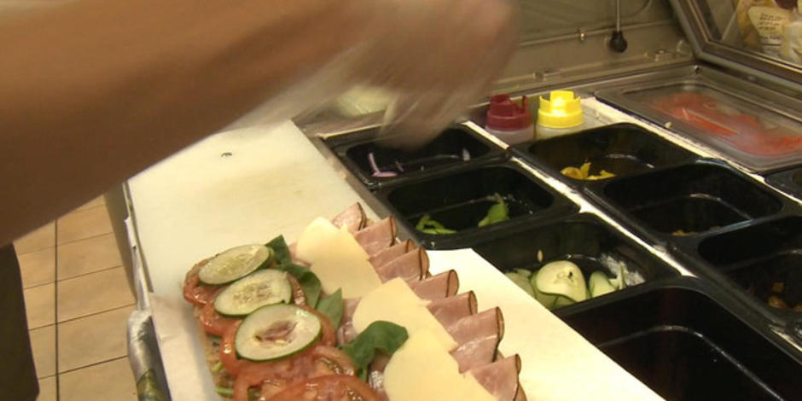
Antibiotic Resistant Bacteria
http://www.cbsnews.com/videos/more-fast-food-chains-pull-away-from-antibiotics-in-meats/
Why is the over prescription of antibiotics bad for people?
Subway restaurants are the latest fast food chain to make a change to their menus. Customers can now order sandwiches made with chickens raised without antibiotics. The switch is prompted by warnings about how antibiotics used on livestock can affect people. Dana Jacobson takes a look at why consumer advocates are praising the move.

Slide 60
Bacteria may be small…but they can reproduce like CRAZY!
http://www.youtube.com/watch?v=gEwzDydciWc

Slide 61
How do bacteria reproduce so easily & quickly?

Slide 62
Bacteria are too simple & primitive to reproduce sexually like plants & animals…
Bacteria don’t do this…

Slide 63
Bacteria are too simple & primitive to reproduce sexually like plants & animals…
Bacteria don’t do this…
NOT SEXUAL REPRODUCTION
http://www.youtube.com/watch?v=sEwmUbzN_-g

Slide 64
But bacteria are too simple & primitive to reproduce sexually like plants & animals…
Bacteria don’t do this…
Bacteria DIVIDE & SPLIT
http://www.youtube.com/watch?v=gEwzDydciWc

Slide 65
But bacteria are too simple & primitive to reproduce sexually like plants & animals…
Bacteria don’t do this…
Bacteria divide & split…
http://www.youtube.com/watch?v=gEwzDydciWc
AND THEY CAN DO THIS A LOT FASTER THAN ANY LIVING THING.
http://www.youtube.com/watch?v=sEwmUbzN_-g

Slide 66
Some bacteria can reproduce asexually (split in 2) as fast as every 20 minutes!
It takes humans 15-45 years to reproduce sexually.

Slide 67
worksheet

Slide 68
Try this problem:
If you have 4 bacteria on your kitchen sponge that can reproduce every hour, how many bacteria would you have in 8 hours?

Slide 69
4x2=8 bacteria after 1 hour
If you have 4 bacteria on your kitchen sponge that can reproduce every hour, how many bacteria would you have in 8 hours?

Slide 70
4x2=8 after 1 hour 8x2=16 bacteria after 2 hours…
If you have 4 bacteria on your kitchen sponge that can reproduce every hour, how many bacteria would you have in 8 hours?

Slide 71
Can you figure this out?

Slide 72
4x2=8 after 1 hour 8x2=16 after 2 hours 16x2=32 after 3 hours 32x2=64 after 4 hours 64x2=128 after 5 hours 128x2=256 after 6 hours 256x2=512 after 7 hours 512x2=1026 bacteria after 8 hours!
If you have 4 bacteria on your kitchen sponge that can reproduce every hour, how many bacteria would you have in 8 hours?
http://www.youtube.com/watch?v=tWfgpHKP0_4

Slide 73
How can bacteria reproduce so fast ??

Slide 74
How can bacteria reproduce so fast??
1. Asexual reproduction (binary fission) is simpler because these unicellular bacteria are just cloning/copying themselves.
http://www.youtube.com/watch?v=1MyiVBkPKgo&feature=fvsr
2.

Slide 75
How can bacteria reproduce so fast??
1. Asexual reproduction (BINARY FISSION) is simpler because these unicellular bacteria are just cloning/copying themselves.
(YOU are one-of-a-kind blend from sexual reproduction!)
http://www.youtube.com/watch?v=1MyiVBkPKgo&feature=fvsr
2.

Slide 76
How can bacteria reproduce so fast??
1. Asexual reproduction (BINARY FISSION) is simpler because these unicellular bacterium are just cloning/copying themselves.
(You are one-of-a-kind blend from sexual reproduction!)
http://www.youtube.com/watch?v=1MyiVBkPKgo&feature=fvsr
2. Bacterium are primitive prokaryotic cells without an inner nucleus to hold their genetic DNA.
BINARY FISSION is easier without a nucleus!

Slide 77
Is all this quick binary fission reproduction good or bad?

Slide 78
Is all this quick binary fission reproduction good or bad?
That depends on whether the bacteria are helpful or hurtful.

Slide 79
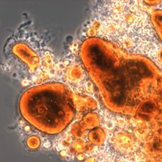
SOME GOOD USES for BACTERIA:
BIOTECHNOLOGY!

Slide 80
SOME GOOD USES for BACTERIA:
BIOTECHNOLOGY!
Certain bacteria can gobble up oil spills!

Slide 81
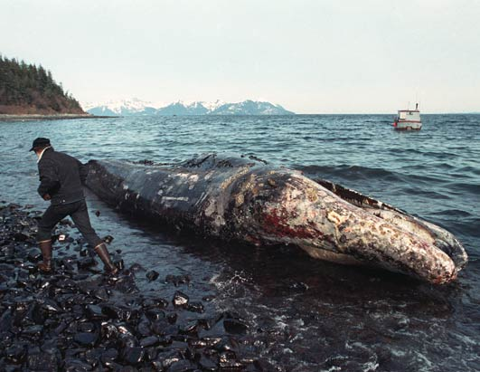
SOME GOOD USES for BACTERIA:
BIOTECHNOLOGY!
Certain bacteria can gobble up oil spills!

Slide 82
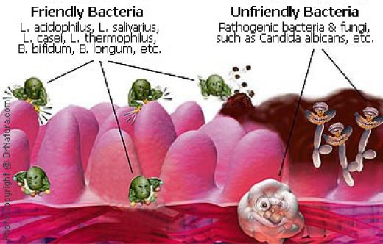
SOME GOOD USES for BACTERIA:
BIOTECHNOLOGY!
Certain bacteria can gobble up oil spills!
Certain species of bacteria help us _ _ _ _ _ _ _ _ _ _.

Slide 83
SOME GOOD USES for BACTERIA:
BIOTECHNOLOGY!
Certain bacteria can gobble up oil spills!
Certain species of bacteria help us digest food!

Slide 84
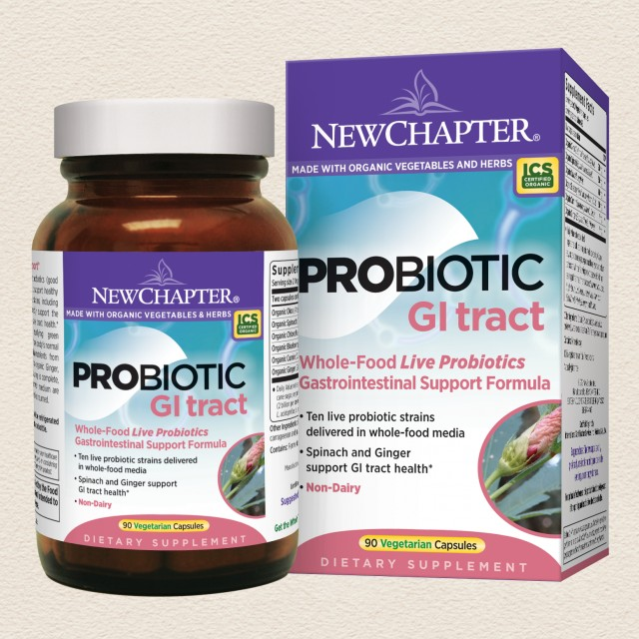
SOME GOOD USES for BACTERIA:
BIOTECHNOLOGY!
Certain bacteria can gobble up oil spills!
Certain species of bacteria help us digest food!

Slide 85
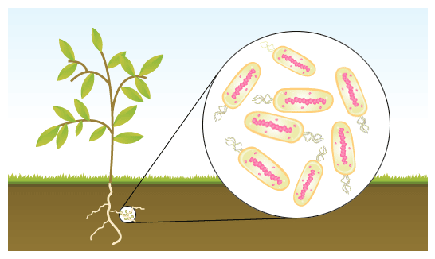
SOME GOOD USES for BACTERIA:
BIOTECHNOLOGY!
Certain bacteria can gobble up oil spills!
Certain species of bacteria help us digest food!
Certain bacteria create _ _ _ _ _ _ _ _ for fertilizing soil.

Slide 86
SOME GOOD USES for BACTERIA:
BIOTECHNOLOGY!
Certain bacteria can gobble up oil spills!
Certain species of bacteria help us digest food!
Certain bacteria create nitrates for fertilizing soil.

Slide 87
SOME GOOD USES for BACTERIA:
BIOTECHNOLOGY!
Certain bacteria can gobble up oil spills!
Certain species of bacteria help us digest food!
Certain bacteria create nitrates for fertilizing soil.
Certain bacteria help us make medicines, foods, & chemicals!

Slide 88
SOME GOOD USES for BACTERIA:
BIOTECHNOLOGY!
Certain bacteria can gobble up oil spills!
Certain species of bacteria help us digest food!
Certain bacteria create nitrates for fertilizing soil.
Certain bacteria help us make medicines, foods, & chemicals!
http://www.youtube.com/watch?v=m3925Pw-VwU

Slide 89
SOME GOOD USES for BACTERIA:
BIOTECHNOLOGY!
Certain bacteria can gobble up oil spills!
Certain species of bacteria help us digest food!
Certain bacteria create nitrates for fertilizing soil.
Certain bacteria help us make medicines, foods, & chemicals!
http://www.youtube.com/watch?v=m3925Pw-VwU

Slide 90
SOME GOOD USES for BACTERIA:
BIOTECHNOLOGY!
Certain bacteria can gobble up oil spills!
Certain species of bacteria help us digest food!
Certain bacteria create nitrates for fertilizing soil.
Certain bacteria help us make medicines, foods, & chemicals!
http://www.youtube.com/watch?v=zmdwvFKC61E

Slide 91
SOME GOOD USES for BACTERIA:
BIOTECHNOLOGY!
Certain bacteria can gobble up oil spills!
Certain species of bacteria help us digest food!
Certain bacteria create nitrates for fertilizing soil.
Certain bacteria help us make medicines, foods, & chemicals!
Certain bacteria is used to purify our water!

Slide 92
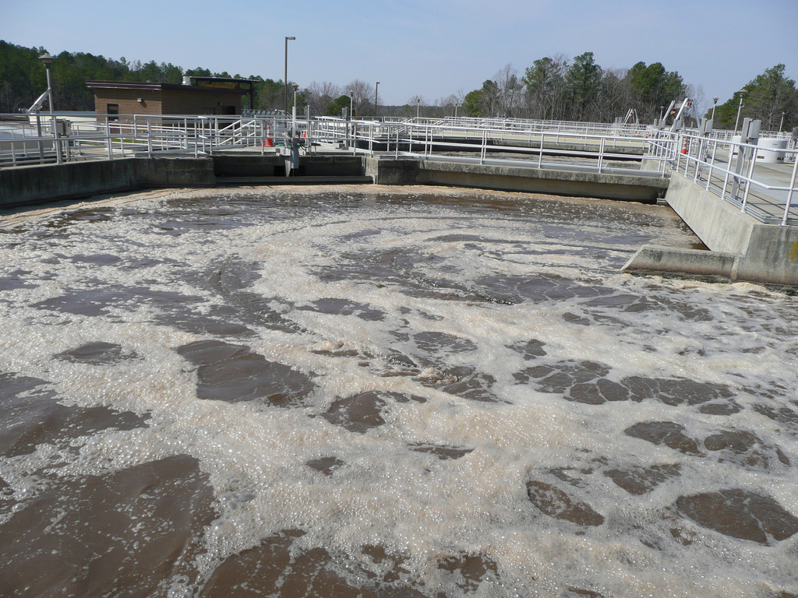
SOME GOOD USES for BACTERIA:
BIOTECHNOLOGY!
Certain bacteria can gobble up oil spills!
Certain species of bacteria help us digest food!
Certain bacteria create nitrates for fertilizing soil.
Certain bacteria help us make medicines, foods, & chemicals!
Certain bacteria is used to purify our water!

Slide 93
SOME GOOD USES for BACTERIA:
BIOTECHNOLOGY!
Certain bacteria can gobble up oil spills!
Certain species of bacteria help us digest food!
Certain bacteria create nitrates for fertilizing soil.
Certain bacteria help us make medicines, foods, & chemicals!
Certain bacteria is used to purify our water!
Certain bacteria are great for decomposing dead stuff so life can begin anew!
http://www.youtube.com/watch?v=Q0xPt_jCFtU

Slide 94
end day 3 of disease…
worksheet

Slide 95
All this quick reproducing bacteria is GOOD unless you get a DEADLY bacteria!
http://www.forbes.com/2006/02/28/cz_mh_0228worsebugslide.html?thisSpeed=6000

Slide 96
All this quick reproducing isn’t bad unless you get a DEADLY bacteria!
In fact, quick reproduction is quite useful in GENETIC ENGINEERING.
http://www.youtube.com/watch?v=m3925Pw-VwU

Slide 97
Many types of bacteria are useful! (believe it or not)
Certain species of bacteria help us _ _ _ _ _ _ _ _ _ _.

Slide 98
Many types of bacteria are useful! (believe it or not)
Certain species of bacteria help us digest food.

Slide 99
Many types of bacteria are useful! (believe it or not)
Certain species of bacteria help us digest food.
Certain species of bacteria create _ _ _ _ _ _ _ for healthy soil for plants.

Slide 100
Many types of bacteria are useful! (believe it or not)
Certain species of bacteria help us digest food.
Certain species of bacteria create nitrates for healthy soil for plants.

Slide 101
Many types of bacteria are useful! (believe it or not)
Certain species of bacteria help us digest food.
Certain species of bacteria create nitrates for healthy soil.
Certain species of bacteria protect us from other nasty contagions (disease causing germs).
show bacterial whisperer!

Slide 102
Many types of bacteria are useful! (believe it or not)
Certain species of bacteria help us digest food.
Certain species of bacteria create nitrates for healthy soil.
Certain species of bacteria protect us from other nasty contagions.
Certain species of bacteria help us make cheeses & yogurts, insulin & other meds, vinegar & other useful chemicals.
http://www.youtube.com/watch?v=zmdwvFKC61E

Slide 103
Many types of bacteria are useful! (believe it or not)
Certain species of bacteria help us digest food.
Certain species of bacteria create nitrates for healthy soil.
Certain species of bacteria protect us from other nasty contagions.
Certain species of bacteria help us make cheeses & yogurts, insulin & other meds, vinegar & other useful chemicals.
Certain species of bacteria helps us clean our _________ water.

Slide 104
Many types of bacteria are useful! (believe it or not)
Certain species of bacteria help us digest food.
Certain species of bacteria create nitrates for healthy soil.
Certain species of bacteria protect us from other nasty contagions.
Certain species of bacteria help us make cheeses & yogurts, insulin & other meds, vinegar & other useful chemicals.
Certain species of bacteria helps us clean our drinking water.
Certain species of bacteria help ________________ __________so life can begin anew.
http://www.youtube.com/watch?v=Q0xPt_jCFtU

Slide 105
Many types of bacteria are useful! (believe it or not)
Certain species of bacteria help us digest food.
Certain species of bacteria create nitrates for healthy soil.
Certain species of bacteria protect us from other nasty contagions.
Certain species of bacteria help us make food cheeses & yogurts, insulin & other meds, vinegar & other useful chemicals.
Certain species of bacteria helps us clean our drinking water.
Certain species of bacteria help break down dead stuff so life can begin anew.

Slide 106
Deadly bacteria…
http://www.forbes.com/2006/02/28/cz_mh_0228worsebugslide.html?thisSpeed=6000

Slide 107
What can make a specific type of bacteria deadly?

Slide 108
What can make a specific type of bacteria deadly?
1.Some deadly bacteria have tough CELL WALLS around them which make them hard for our white blood cells to conquer.
http://www.youtube.com/watch?v=eoK3XcwChW4
2. Some deadly bacteria have become resistant to our antibiotics medicines because we’ve overused them.
http://www.youtube.com/watch?v=1MyiVBkPKgo&feature=fvsr

