Slide 1
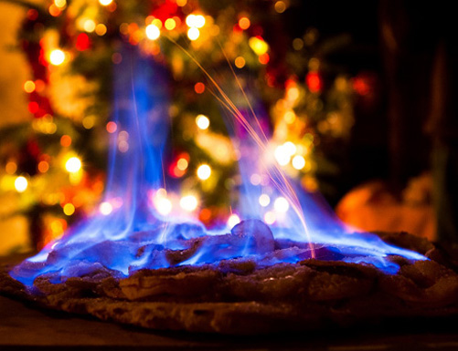
Chemical and Physical Change Notebook Page 25

Slide 2
Warm Up January 7, 2019 Page 24
Which two families on the periodic table of elements are most reactive?
Which group on the periodic table of elements is least reactive and why?
SPIRAL: How many neutrons are there in a single Vanadium atom?
Objectives: 8.P.1.3
-TSW understand the difference between chemical and physical changes.
Essential Question:
-What is the difference between a chemical and physical change?

Slide 3
Warm Up January 8, 2019
What are two physical properties of matter?
Provide at least one example of a physical change of matter.
Spiral: Which of the following is the best example of a homogeneous mixture? WHY?
a) element b) molecule c) mixture d)solution
Objectives: 8.P.1.3
-TSW understand the properties of matter including chemical and physical changes.
Essential Question:
-How do chemical changes differ from physical changed?

Slide 4
Warm Up January 9, 2019
What is a chemical reaction?
What is the difference between a chemical change and a physical change? Provide at least one example for each.
Spiral: Which group of elements on the periodic table would conduct energy the best?
Objectives: 8.P.1.3
-TSWU the properties of matter including chemical and physical change s
Essential Question:
-What is the difference between a chemical change and a physical change?

Slide 5
Warm Up January 10, 2019
How can a scientist determine if a chemical change has occurred during an experiment?
Spiral: Why do atoms typically have a neutral charge?
Draw a t-chart and determine whether the following substances are examples of a physical or chemical change and explain why……
Objectives: 8.P.1.3/1.4
-TSWBAT identify examples of a physical and chemical change?
-TSWU how you can increase the rate of a chemical change.
Essential Question
-How can you increase the rate of a chemical change?

Slide 6
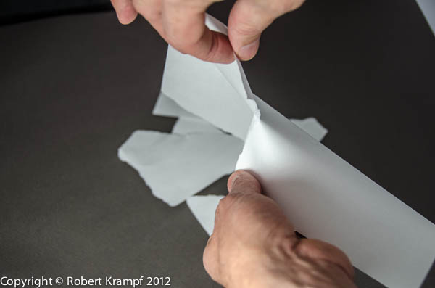
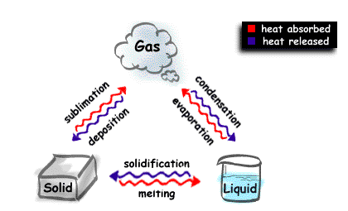
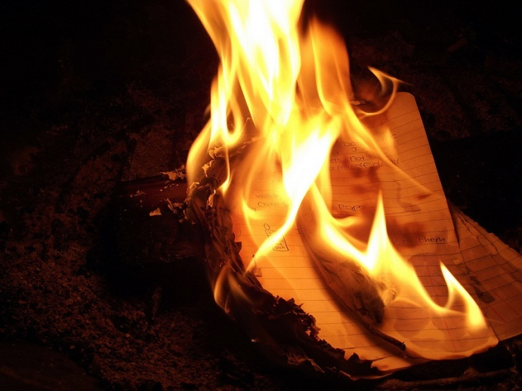
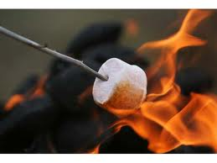
Fireworks
Tearing paper into smaller pieces
Water changing from a solid, liquid, or a gas
Burning paper
Roasting marshmallow

Slide 7
Warm Up December 18
1. The chemical formula for sugar is C₆H₁₂O₆. How many oxygen atoms would be in 5 sugar molecules?
2. How many hydrogen atoms are in 3 C₆H₁₂O₆ compound molecules?
3. How many carbon atoms are in 4CO₂ compound molecules?
4. How many total atoms are in 4CO₂ compound molecules?
5. If 2 water molecules (2H₂O) mixed with 2 hydrochloric acid molecules (2HCl), how many hydrogen atoms would you have?

Slide 8
Warm Up December 6
Name and describe any two physical properties that you are familiar with.
Name and describe any two chemical changes a substance can go through during a chemical reaction.
How many hydrogen and oxygen atoms are in 4 molecules of peroxide (H2O2)?
Objectives: 8.P.1.3/1.4
-TSWBAT identify physical properties of various substances.
Essential Question:
-What are physical properties of a substance?

Slide 9
Warm Up November 30
Atoms of an element will always have the same number of _________.
Which group of elements is often used to kill bacteria? Page 29 D

Slide 10
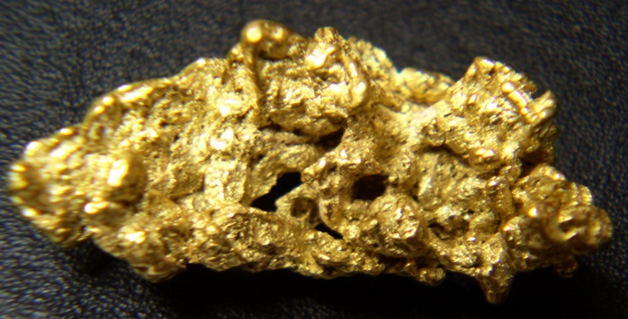
What is a Physical Property? skip 3 spaces between each…
Take a few seconds and discuss with your group the meaning of a physical property.
Provide Examples of physical properties.
Identify the physical properties of gold.

Slide 11
Physical Properties
Physical properties- involve things that can be measured without changing the chemical properties of matter.
Mass- the amount of matter contained in a substance
Volume- Amount of space an object occupies
Density = mass divided by the volume of a substance (mass/volume)
A cube has a mass of 4.2g and a volume of 5.3 mL. What is its density?
Liquid has a mass of 27.2g and a volume of 2.0mL. What is its density?

Slide 12
Density Continued
The density of water is 1.0g/mL
Which of these would float in water?
.792g/ml
13.6g/mL

Slide 13
Physical Properties continued
Solubility- the ability for a substance to dissolve in another substance.
Sugar in coffee or tea
Malleability- the ability to be hammered into thin sheets.
Boiling Point- temperature at which a liquid changes to a gas at a given pressure.
Specific Heat- the amount of energy needed to raise one gram of a substance by one degree Celsius.

Slide 14
All Types of Physical Properties
Appearance – is it shiny or dull (luster)
Texture – what does it feel like? Smooth or rough?
Odor – smell
Melting point – solid to a liquid (ice to water)
Boiling point – liquid to a gas (water to water vapor)
Density – m/v, how much mass is in a space
Solubility – the ability of a solute to dissolve in a solvent.
Polarity – having opposite poles or being polar. Like a water molecule. Positive and negative end. Like a magnet.
Freezing point – liquid to a solid

Slide 15
Discussion Points
Turn to your “buddy next to you and try to identify 3 ways a substance can change physically…
Write them down
Discovery Ed Clip
Physical Changes
6:43

Slide 16
Physical Changes– page 13
Physical Change- Change in the state of a substance. It can be reversed.
Water can physically change from a solid, liquid, or gas.
Sugar dissolves in water but can be reversed by evaporating the water.
Physical changes can be reversed most of the time.
The substance does not changing chemically!!

Slide 17
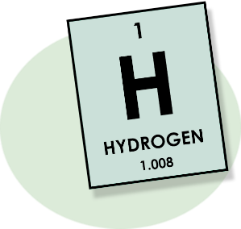
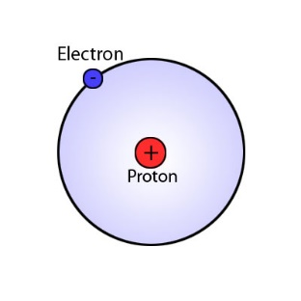
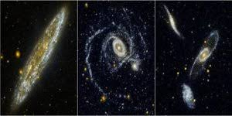
What is a Chemical Property? skip 3 spaces between each…
Take a few seconds and discuss with your group the meaning of a chemical property.
Provide an example of a chemical property.
Identify the chemical properties of Hydrogen.

Slide 18
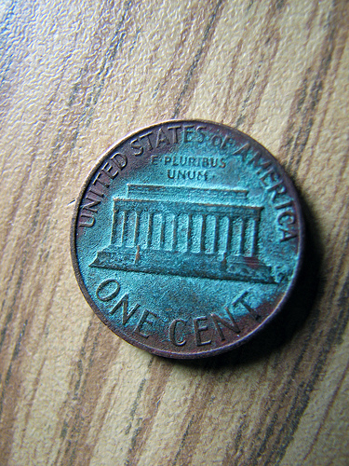
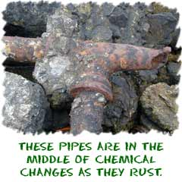
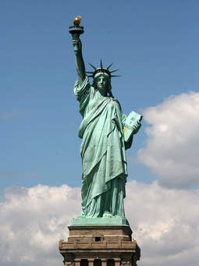
Chemical Changes
Chemical Change- Change of one substance into another substance. Chemical changes cannot be reversed.
When water reacts with copper – copper turns from brown to green
Iron Rusts
Statue of Liberty

Slide 19
Chemical Properties
The following properties show chemical changes taking place in a substance.
Heat given off from combustion – fire
Chemical reactivity
Toxicity
Oxidization
Rust
Flammability
Formation of chemical bonds between valence electrons
Chemical changes are irreversible and the chemical properties of the substance changes.

Slide 20
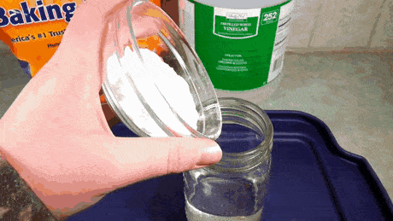
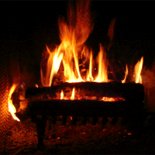
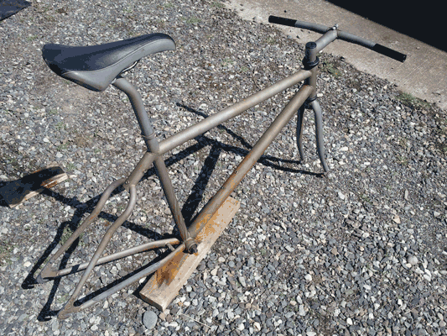
Chemical Changes
Food spoiling
Digestion
Cooking food
Baking a cake
Mixing baking soda and vinegar
Burning wood
Rusting bicycle
These are all examples of chemical because they are irreversible and new substances are being formed.

Slide 21
4 evidences of a chemical change
Gas is produced
Formation of a precipitate
Temperature change
Color change

Slide 22
Discussion Points
Turn to your “buddy next to you and try to
1. Identify 3 ways a substance can change chemically…
2. How do the properties of
a product compare to the
properties of the reactants
after a chemical reaction?
Write your answers down
Discovery Ed Clip
Chemical Changes
6:10

Slide 23
Physical Change or Chemical Change
Rusty Nails

Slide 24
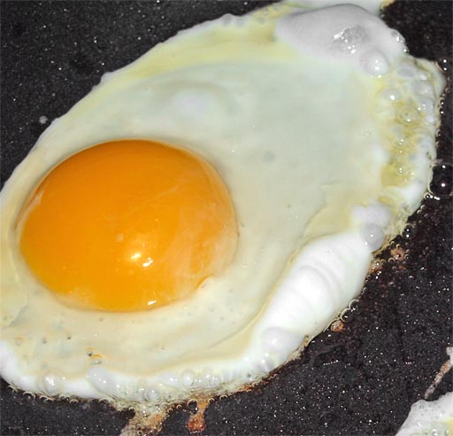
Physical Change or Chemical Change
2. Fried Egg

Slide 25
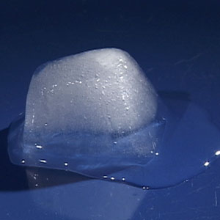
Physical Change or Chemical Change
3. Ice Melting

Slide 26
Physical Change or Chemical Change
4. Burning
Wood

Slide 27
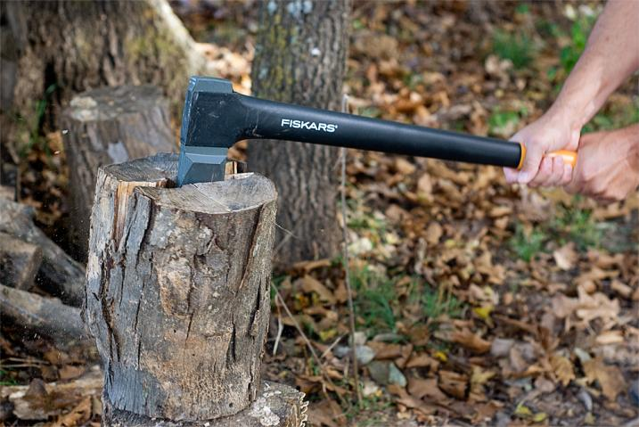
Physical Change or Chemical Change
5. Splitting Wood

Slide 28
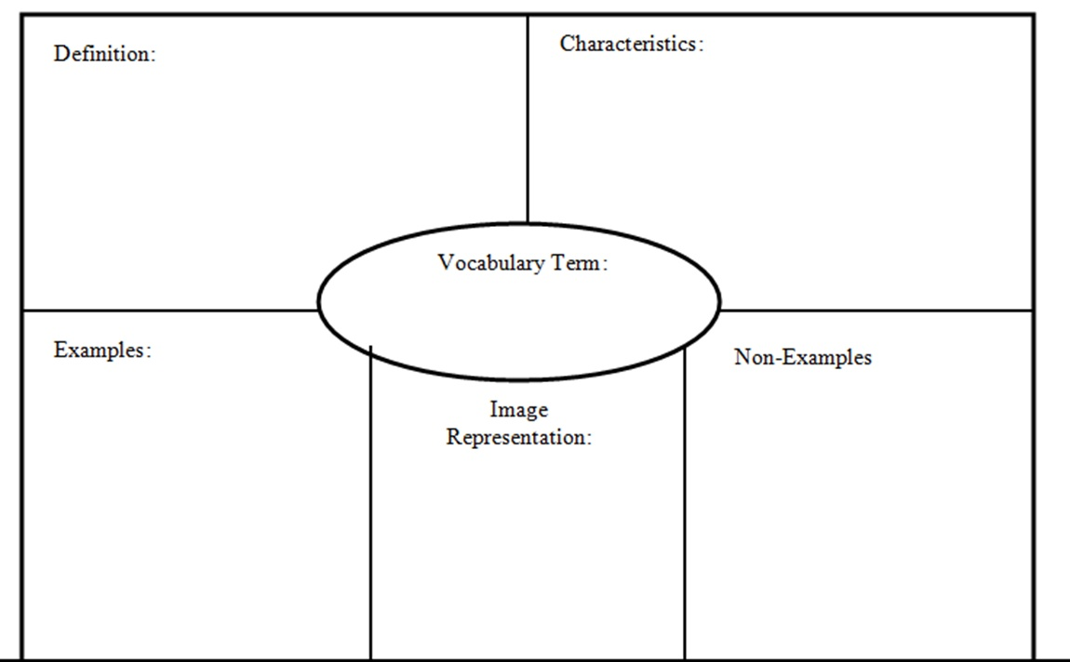
Chemical vs. Physical Change

Slide 29
Physical and Chemical Changes Quiz
http://www.mcwdn.org/chemist/pcchangequiz/pcchangequiz.html
BILL NYE: CHEMICAL REACTIONS VIDEO NOTES- Notebook Page 27
-12 facts
-1 colored picture

Slide 30
BILL NYE: CHEMICAL REACTIONS VIDEO NOTES- Notebook Page 26
-Draw 3 column chart
How are new chemicals formed?
What reacts with iron to create rust?
Why is our blood red?

Slide 31
Bill Nye Chemical Reactions Discussion Points
Tell me how your stomach growling shows evidence of a chemical reaction.
How is baking a cake an example of a chemical reaction?
What is the difference between a chemical change and a physical change.
Describe three common physical change you have seen at home.
Describe three chemical changes you have seen at home.

Slide 32
Physical and Chemical Properties Wrap Up

