Slide 1
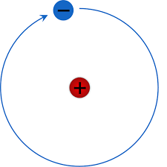
The Atomic Structure, Bohr’s Model, and LEWIS DOT STRUCTURE Directions: Complete the practice problems below in your notebook on page 15. Hydrogen has been modeled for you. Be sure to include all three steps for each.
H ydrogen Helium Lithium
P= 1
E= 1
N= 0
V.E.= 1
Oxygen Neon Aluminum

