Slide 1
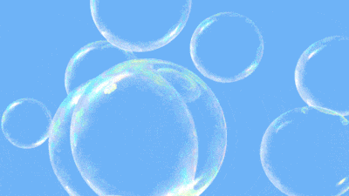
Pathogens: Disease Causing Microbes
Bubble Maps

Slide 3
Bubble Maps: Reflection
Which of these diseases can be treated with antibiotics?
Lyme disease b) the common cold c) influenza d) AIDS
Which type of pathogen causes athletes foot?
Bacteria b) insect c) fungus d) virus
Which of the following reproduces by injecting its genetic material into a host cell?
Parasite b) virus c) bacterium d) microorganism
Which of the following are likely to be either spherical, rod-shaped, or spiral shaped?
Bacteria b) viruses c) eukaryotes d) parasites
A vaccine is made from
Proteins produced by the body b) a weak or dead form of a pathogen
c) Body cells that are immune to a disease d) antibiotics

