Slide 1
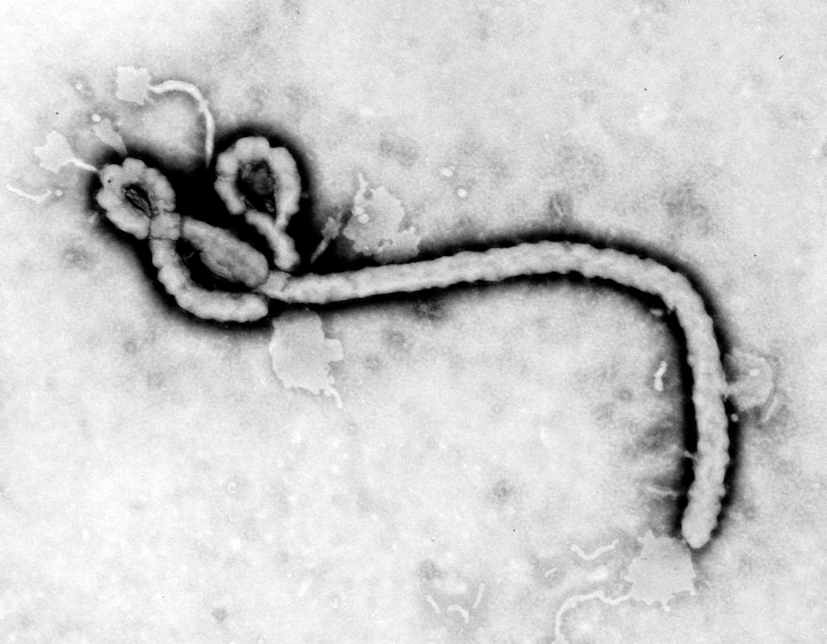
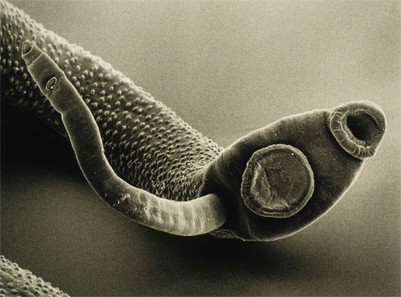
4.3 E Disease Prevention Parasites
March 13-14
PAGE 24
Ebola Virus
Parasites in the Body

Slide 2
Warm Up 3/13/2017 Warm Up Page 23
Compare and Contrast: What is the difference between the reproductive process of bacteria and the reproductive process of a virus? ? E 89 and E 134
What is a parasite?
Would you consider bacteria and viruses a parasite? Explain your answer…
Objectives: 8.L.1.1
-TSW understand the characteristics of bacteria, viruses, and parasites, and fungi.
Essential Question:
- How are bacteria, parasites, fungi, viruses similar and different?

Slide 3
Warm Up W 3/10/2017 Warm Up Page 23
What is a parasite? Provide at least one example…
What is a parasitic relationship? Provide at least one example…
Why would bacteria and viruses be considered a parasite?
Objectives: 8.L.1.1
-TSW understand the characteristics of fungi.
Essential Question:
- How are bacteria, parasites, fungi, and viruses similar?

Slide 4
Warm Up April 27-28
What is a Pathogen?
What is used to treat bacterial infections?

Slide 5
Pathogens- Bacteria and Viruses are known as Pathogens.
Microorganisms – The organisms that cause sickness
Virus, bacteria, fungi and protists (proterozoa).
Bacteria – single celled organisms that live almost everywhere.
Bacteria can cause ear infections and strep throat.
Viruses - nonliving, do not have a cell membrane, must live inside another cell (host) in order to reproduce, they mutate and evolve very quickly, cause harm to the host.
Small pox, cold sores, influenza or flu, AIDS

Slide 6
Infectious Diseases Can Spread
They can spread through food, air, and water
Ecoli
Infectious diseases can spread through contact with insects and animals
Rabies, Lime Disease, and Malaria
They can spread through person – to – contact.
AIDS

Slide 7
Preventing Infectious Diseases
Better education leads to better nutrition and vaccines.
Antibiotics – used to fight and kill off Pathogens (bacteria, protists, fungi)
Resistance – when antibiotics are used, bacteria and other living organisms can develop an immunity.

Slide 8
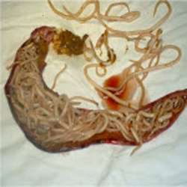
Parasite
What is a Parasite?
A parasite lives in a close relationship with another organism, its host, and causes it harm. The parasite is dependent on its host for its life functions.
This relationship between the host and the parasite is known as a parasitic relationship.
Parasite in the human body!
Parasites can enter the body by means of food or water.

Slide 9
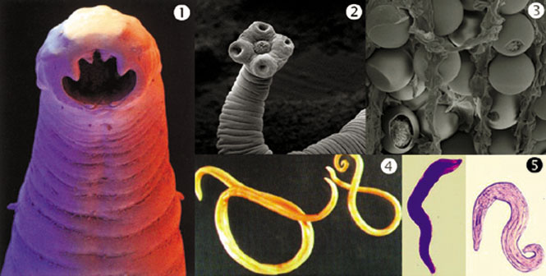
Parasite DQ’s
A parasite typically does not kill their host, at least not at first. Why would a parasite keep their victims alive for as long as possible?

Slide 10
Monsters Inside Me: Wendy’s Parasite
Why is the organisms inside Wendy considered to be a parasite?
How is the parasite dependant upon the host?
How did the organisms living inside Wendy affect her?
How did the parasite enter Wendy’s body?
How is the parasites life cycle repeated?

Slide 11
Monsters Inside Me: Jonathan’s Parasite
Why is the organisms inside Jonathan considered to be a parasite?
How is the parasite dependent upon the host?
How did the organisms living inside Jonathan affect him?
How did the parasite enter Jonathan’s body?
How is the parasite’s life cycle repeated?

Slide 12
Monsters Inside Me: Kelly’s Parasite
Why is the organisms inside Kelly considered to be a parasite?
How is the parasite dependent upon the host?
How did the organisms living inside Kelly affect her?
How did the parasite enter Kelly’s body?
How is the parasites life cycle repeated?

Slide 14
Bacteria, Viruses and Other… Reflection
Name 2 features that all bacteria share.
What three shapes can bacteria have?
How can bacteria be helpful? How can they be harmful?
How does a virus harm a host cell?
Why are viruses not considered to be living organisms?
What is a parasite?
Analyze: Parasitic bacteria do not usually kill their hosts, at least not quickly. For a parasite, why is it better not to kill the host? EXPLAIN….
Compare and Contrast: What features do viruses and cells have in common? How are they different?

