Slide 1
Health and Macromolecules
Notebook Page 14

Slide 2
Warm Up Warm Up Page 13 2/24/2017
What are the 3 main phases of cell division?
What is the shortest period during a cell’s life cycle? Explain the phase…
What is the longest phase during a cell’s life cycle. Explain the phase…
Objectives: 8.L.5.3
-TSWU the basic functions of several cell functions and identify how the choices we make can have a negative impact on human body systems.
Essential Question:
-How can chemicals impact the health of the human body system?

Slide 3
Cell Division and Mutagens
Complete the notes on cell division and mutagens
Introduce Macromolecules/ Macronutrients
Health Activity

Slide 4
Carbon based molecules are the building blocks of all life.
Macromolecule: otherwise know as a macronutrient is a molecule containing a very large number of atoms.
Living things contain 4 major types of macromolecules including:
Carbohydrates – include sugars and are essential for energy in the cell
Lipids – include fats and oils and are important for cell structure
Proteins – are made from amino acids
Nucleic acids – contain information used to make proteins and are found in the nucleus. These include DNA

Slide 5
Can you match the following cell processes with their correct macromolecule?
CELL PROCESSES MACROMOLECULES
Cell Respiration Lipids
Protein Synthesis Nucleic acids
Osmosis and Diffusion Carbohydrates
Mitosis Proteins

Slide 6
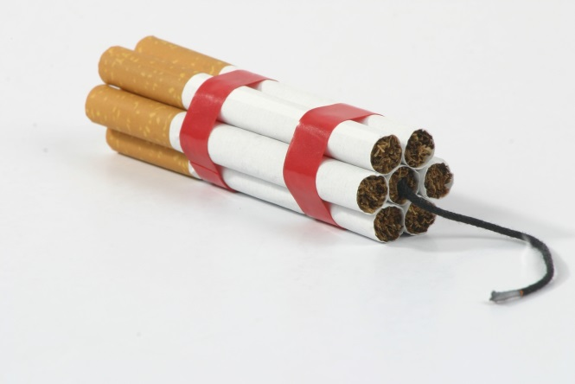
CDC: Tips From Former Smokers

Slide 7
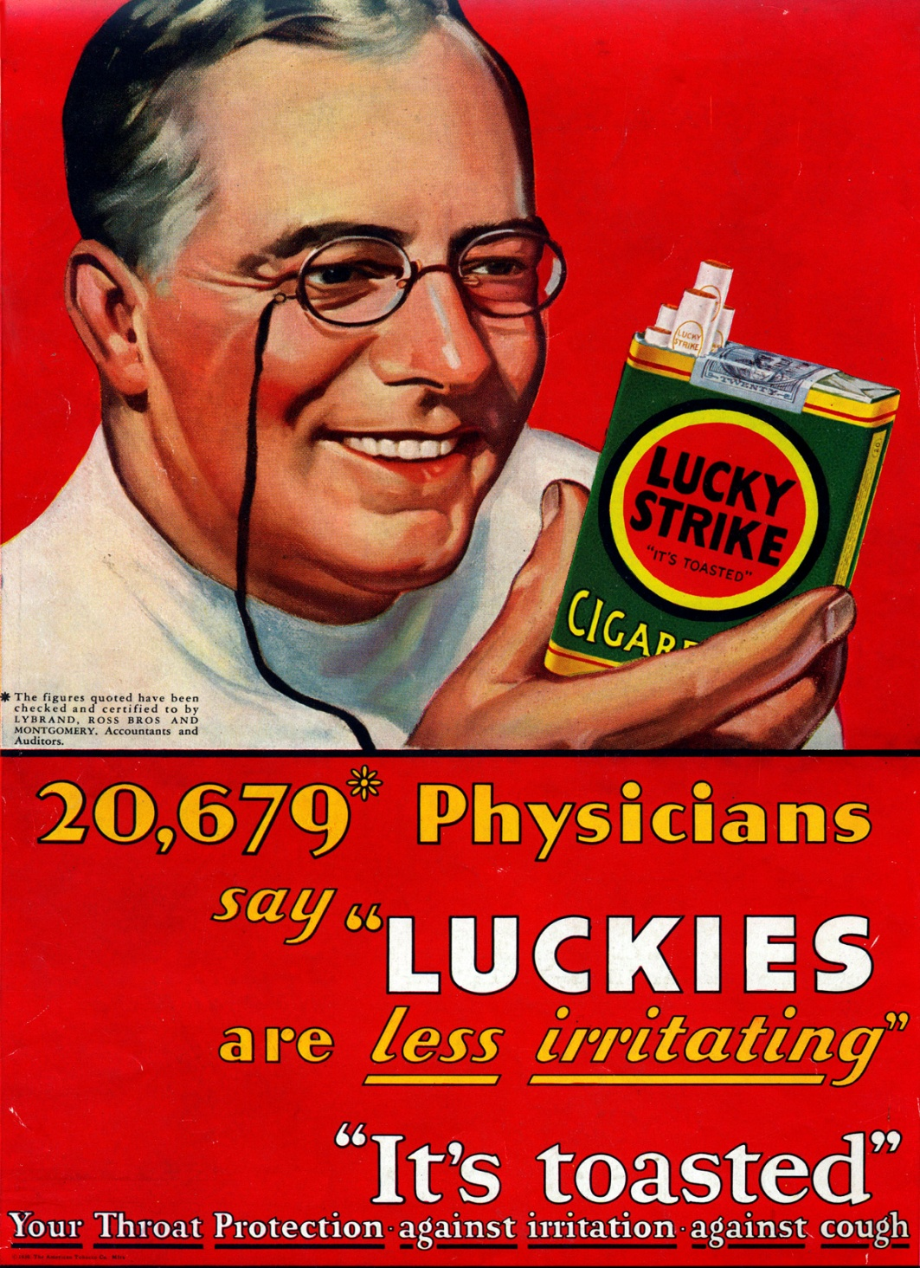
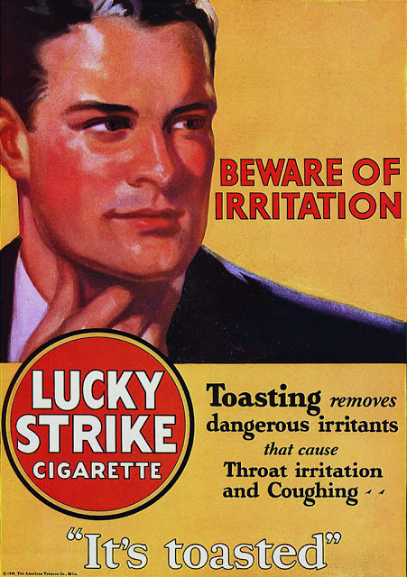
Smoking Ads – 1920’s

Slide 8
Smoking Ads – 1930’s

Slide 9
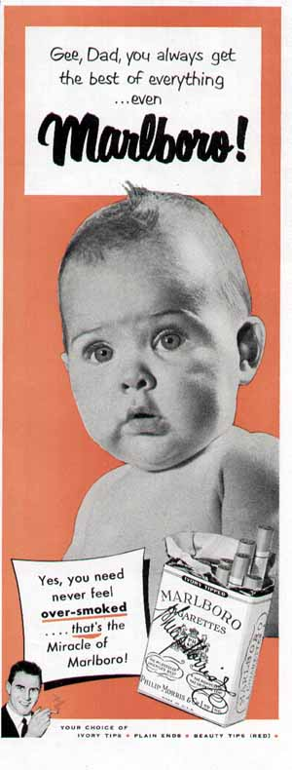
Smoking Ads – 1940’s

Slide 10
Smoking Ads – 1950’s

Slide 11
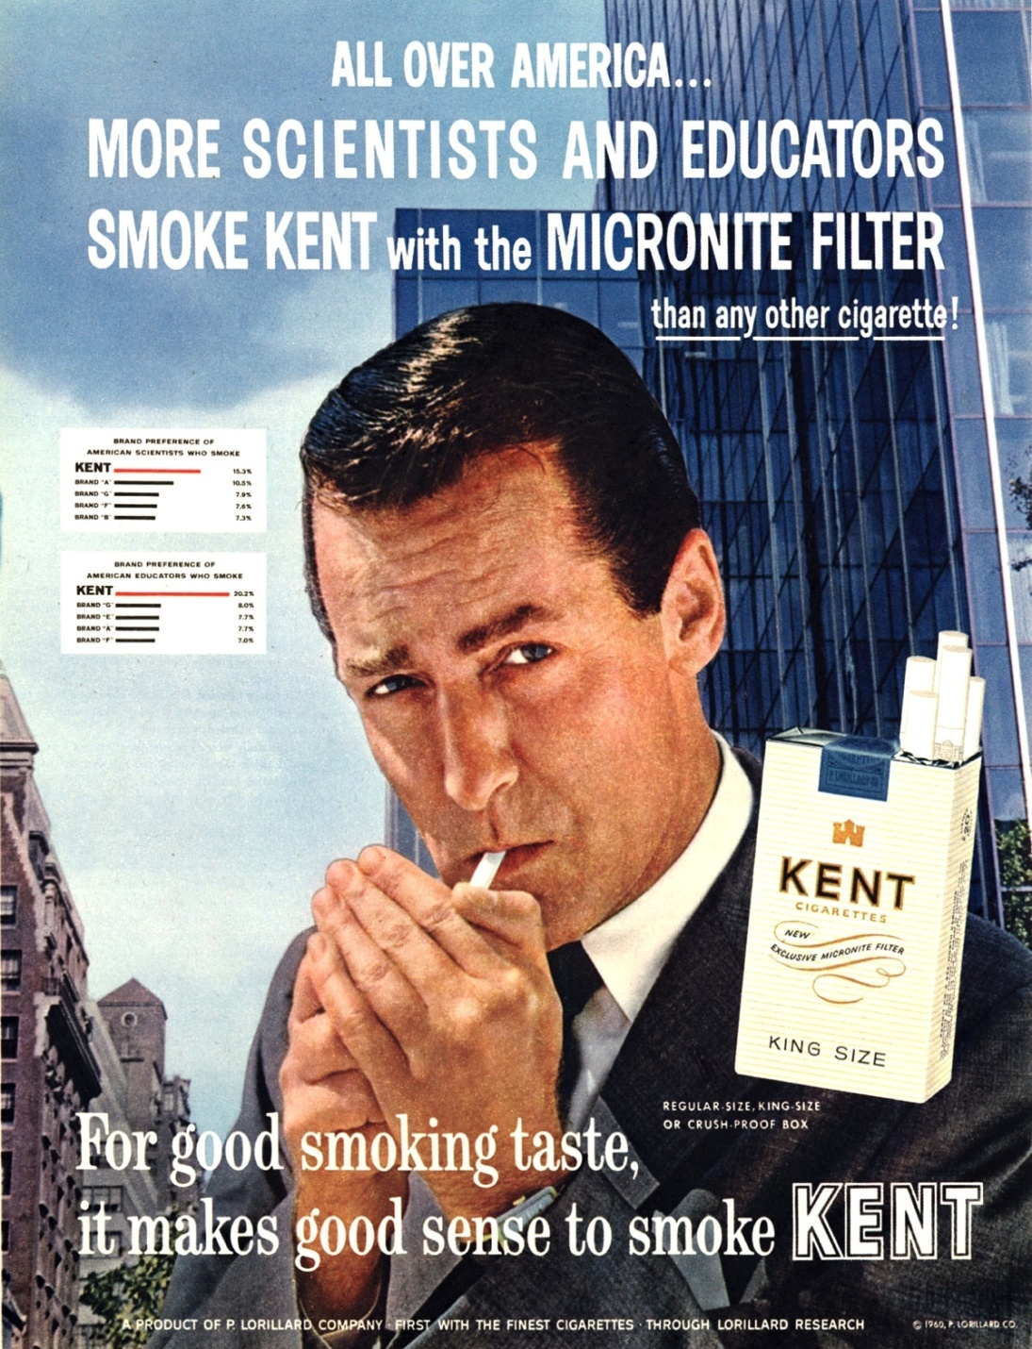
Smoking Ads – 1960’s

Slide 12
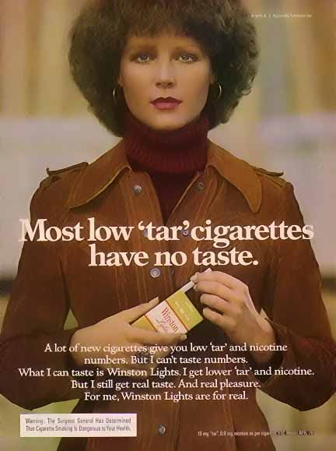
Smoking Ads – 1970’s

Slide 13
Smoking Ads – 1980’s

Slide 14
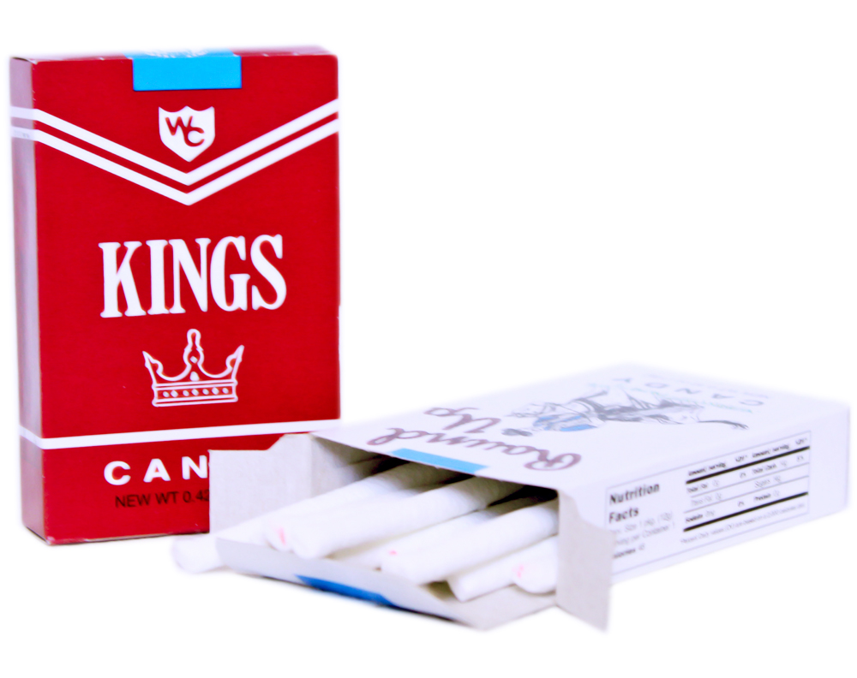
Smoking Ads – 1990’s

Slide 15
Smoking Ads – 2000’s

Slide 16
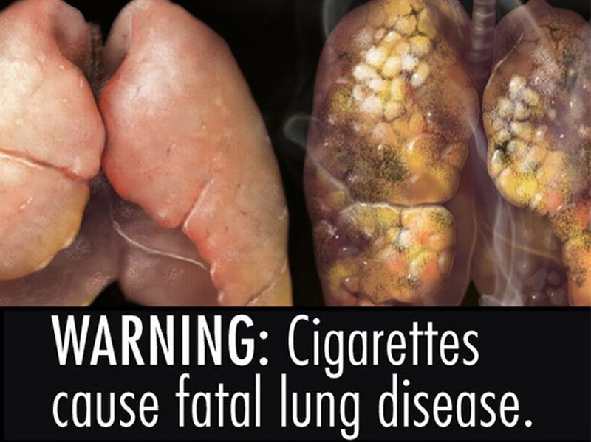
Guided Notes
Tobacco mostly affects your circulatory (heart) and respiratory (lungs) systems.
Tobacco can also affect other systems due to indirect reasons (such as causing holes in your throat’s skin)

Slide 17
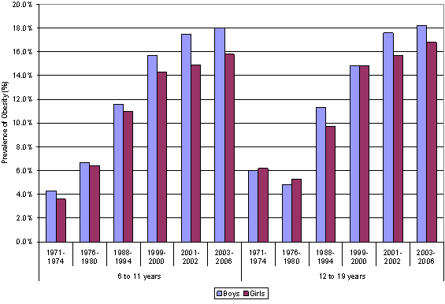
Childhood Obesity

Slide 18
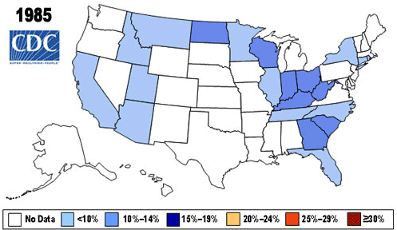
Childhood Obesity – by state

Slide 19
Childhood Obesity – our current rate by 2030

Slide 20
Guided Notes
Alcohol mostly affects your liver and kidneys.
Excessive amounts of anything into your body (tobacco, alcohol just some examples) can lead to cellular problems. Sometimes, it can lead to mutations, which is when your cells send DNA to the wrong place, which can lead to organelle production problems, which in turn cause problems in mitosis.

Slide 21
Additional Health Notes
Although our body and cells need nutrients excessive amounts can be harmful.
If the amount of calories is greater than the amount of calories burned weight will increase
We use most of our body’s energy to breath, blink, and circulate blood using our heart.
10% of our energy is used for digesting food that we eat

Slide 22
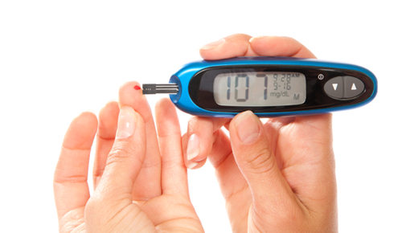
Additional Health Notes
To much sugar can lead to diabetes
To much fat/lipids can lead to heart disease

Slide 23
Anti Smoking Ad
Create an anti smoking ad that you may find in a popular teen magazine.
Include a title for your anti smoking ad.
Include pictures, statistics, and/or sayings to help others make a smarter life decision.
Be Smart, Don’t Start!
Identify 6 ways smoking can negatively impact the human body.

