Slide 1
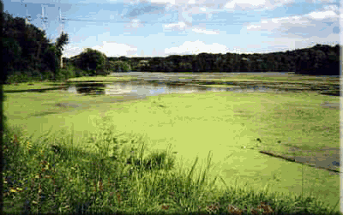
Eutrophication
Literacy Activity
Modified Schedule

Slide 2
Warm Up October 29, 2019
1. What is eutrophication?
What does eutrophication cause?
Is eutrophication in water good or bad?
2. Which nutrients can lead to eutrophication in a pond or lake?
Where do these nutrients come from? Phosphates & Nitrates
How do these nutrients get into lakes or ponds?
Objectives: 8.E.1.3 and 1.4
-TSWU how nitrate and phosphate pollution can have a negative affect on water quality.
Essential Question:
-How can pollution affect water quality?

Slide 3
The Fish Kill Mystery

Slide 4
The Fish Kill Mystery – Case Study
In cooperative groups, Close read the article, “The Fish Kill Mystery.”
Annotate the article using the following guide →
1 questions
1 surprise
1 connection
5 unknown vocabulary
Complete 5 Step assessment questions/worksheet
Resources:
Article, “The Fish Kill Mystery”
What is Eutrophication Text
Textbook Page NC8, NC11-NC13
Everything on a separate sheet of paper, glued, name, and block.
Annotations
WRITE QUESTION
HIGHLIGHT
WRITE SURPRISE
WRITE CONNECTION
HIGHLIGHT WORDS

Slide 5
The Fish Kill Mystery – Case Study

Slide 6
The Fish Kill Mystery – Case Study: Extension

Slide 7
Brain Pop: Water Pollution 3:15

Slide 8
Coach Book Review
An example of non-point source pollution is
a) A pipe leaking waste b) runoff carrying fertilizers c) a barrel leaking oil
A clear example of point source pollution is
a) Trash floating in an ocean b) waste from a feedlot in a river c) oil taker leaking
What is the possible effect of high nutrient levels in water systems?
a) Algae blooms b) less algae c) healthier fish
Which of the following occurs when algae decompose in the ocean?
a) Decomposers at the ocean's surface remove oxygen from the air
b) Decomposers add oxygen to the ocean water
c) Decomposers remove oxygen from the ocean water
Under which conditions are large numbers of fish in a lake most likely to die?
a) Right after a storm with heavy rainfall c) when water’s dissolved oxygen is high and temps are low
b) When dissolved oxygen is low and temperatures are high
An algae bloom in a water system is most likely caused by
a) nutrients in runoff b) high levels of oxygen c) increased use of fossil fuels

