Slide 1
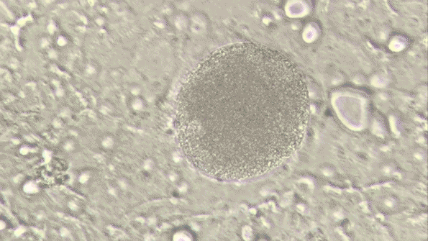
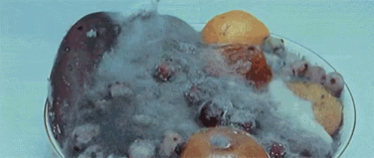
What organisms do MICROBIOLOGISTS study?
Disease Causing Microorganisms
Wrapping up microbes
Notebook page

Slide 2
1) Title Page :
-Bacteria, Viruses, and Other Microorganisms
-Name, date, and block
-1 Colored picture with a caption
2) Five Tabs
-Title each tab
-5 facts per tab
-1 colored picture with a caption per tab
3) Reflection 1-10
Write and answer each question on the back.
Bacteria, viruses, and other microorganisms
Name, Date, Block
Bacteria
138E-139 E and Notes
Viruses
146E-150E and Notes
Fungi
66B and Notes
Parasites
141E-153E
and Notes
Reflection
1-10 on back

Slide 3
Other Microorganisms Poster Reflection
Name 2 characteristics that all bacteria have in common.
What three shapes can bacteria have?
How can bacteria be helpful? How can they be harmful?
Why are viruses not considered to be living organisms?
How does a virus harm a host cell?
What is a parasite?
Analyze: Parasitic bacteria do not usually kill their hosts, at least not quickly. For a parasite, why is it better not to kill the host? EXPLAIN….
Compare and Contrast: What features do viruses and cells have in common? How are they different?
Which living pathogen causes the disease Malaria in humans and is spread by a vector such as mosquitos?
Identify a disease the following pathogens might cause? Bacterium, Virus, Fungi, Protist

