Slide 1
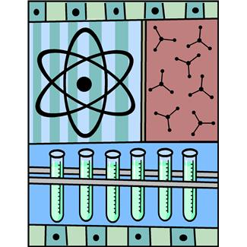
Mixtures, Solutions, and Suspensions
Chapter 4 D
Power Point Notes

Slide 2
Warm Up December 9 NEW WARM UP PAGE 18
What is solubility?
What is the difference between a solute and a solvent? Provide one example for each.
What does it mean if something is insoluble? Can you provide an example?
Objectives: 8.p.1.1
-TSW understand the difference between a mixture and a solution.
Essential Question:
-What is the difference between a mixture and a solution?

Slide 3
Warm Up December 9, 2014
What is the difference between a molecule and a compound?
Give one example of a molecule and 1 example of a compound.
What is the difference between a heterogeneous mixture and a homogeneous solution? Provide one example for each.
Objectives: 8.P.1.1
-TSW understand the difference between a mixture, solution, and a suspension.
Essential Questions:
- What is the difference between a heterogeneous mixture and a homogeneous solution?

Slide 4
Discovery Education
www.discoveryeducation.com
Username:
studentIDnumber_CMS
Password:
StudentIDnumber

Slide 5
Warm UP December 7
What is a solution?
Give one example of a physical change and 1 example of a chemical change.

Slide 6
Warm Up December 10
1. Describe a heterogeneous mixture. Provide an example
2. Describe a homogeneous mixture. Provide an example

Slide 7
Objectives
TSW understand Covalent and Ionic Bonds.
TSW understand the difference between heterogeneous and homogeneous mixtures.

Slide 8
Warm Up December 14
What is a covalent bond?
What is an Ionic Bond?

Slide 9
Objectives
TSW understand the difference between covalent and ionic bonds.
TSW understand how covalent and ionic bonds form.

Slide 10
Solutions
A mixture is a combination of 2 or more substances.
Heterogeneous mixture is not the same throughout. Like a salad.
Homogeneous solution- a type of mixture that is the same throughout.
All portions of a solution are exactly the same.
Sugar dissolved in water is a solution
Sand and water mixed up is not a solution.
Solute- a substance that is dissolved to make a solution.
Sugar and Salt
Solvent- A substance that dissolves a solute
Water

Slide 11
Solutions
Types of Solutions
Solutes, solvents, and solutions can be solids, liquids or gases.
Example: CO2 (gas) is dissolved in liquid to give pop carbonation.
Example : Sugar (solid) is dissolved in liquid to give pop its sweet taste.
The solvent is the substance that is the greater amount.
Example:
H2O
Hydrogen is the Solvent because it is the greater amount 2-H and 1-O

Slide 12
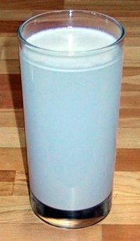
Suspensions
Suspension- when the dissolved particle (solute) are larger than the solvent.
Instead of dissolving, the solute turns the liquid cloudy. Because they don’t fully dissolve.
Example: Add 1 table spoon of flour to a cup of water. What happens?
Some particles will settle out

Slide 13
Concentrations
Concentration- how much solute is dissolved in a solvent at a particular temperature.
Example: Well Water vs. Sea Water
Dilute- low concentration
Example: small amount of sugar in water
Saturated- high concentration
Maximum amount of solute dissolved in a solvent

Slide 14
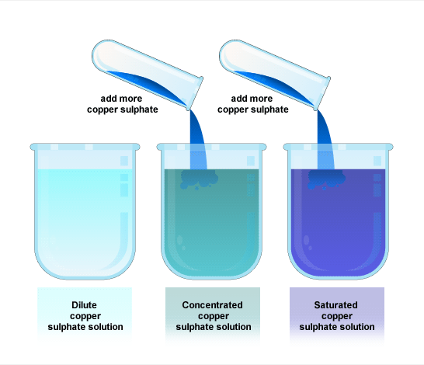
Dilute vs Saturated

Slide 15
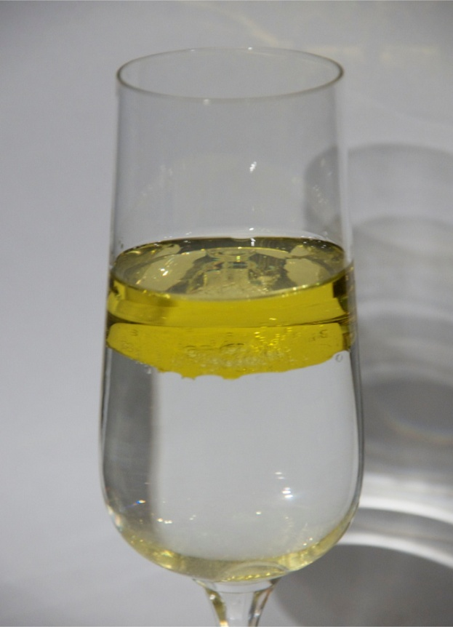
Solubility
solubility- amount of solute that will dissolve in the solvent at a certain temperature
insoluble- when one substance will not dissolve into another
Example: Oil and Water

Slide 16
Chemical Formulas
Chemical formulas- use chemical symbols to represent the atoms of the elements and their ratios in a chemical compound.
Subscript- a number written to the right of a chemical symbol.
CO2

Slide 17
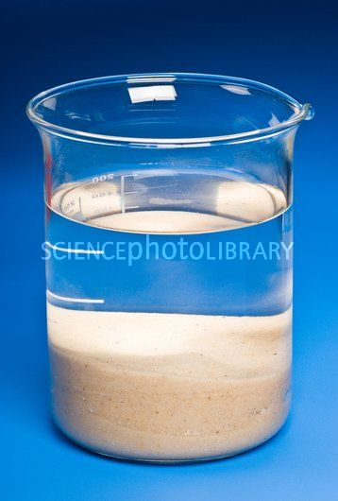
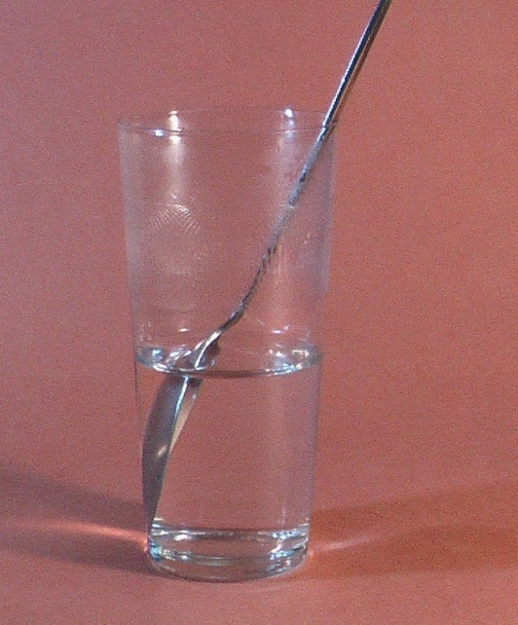
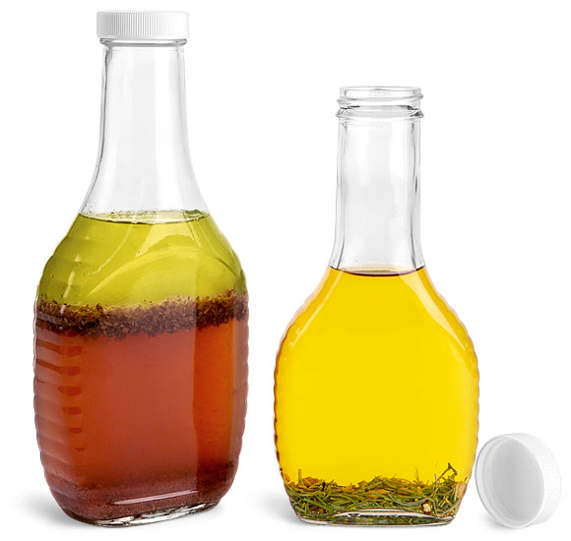
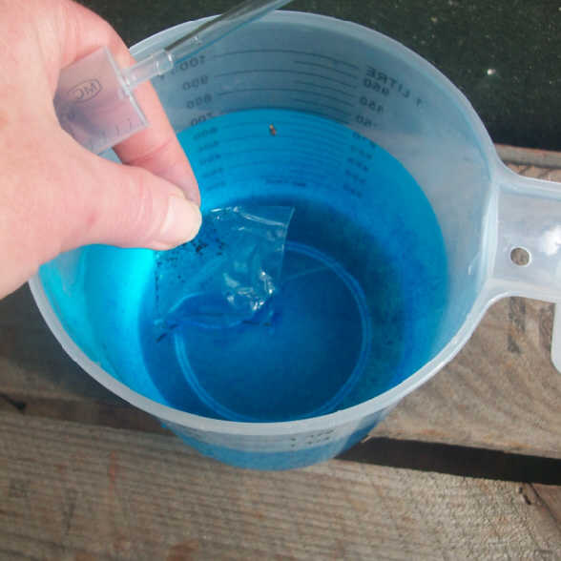
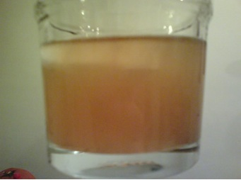
Mixtures, Solution, and Suspensions
Sample 1
Sample 2
Sample 3
Sample 4
Sample 5

Slide 18
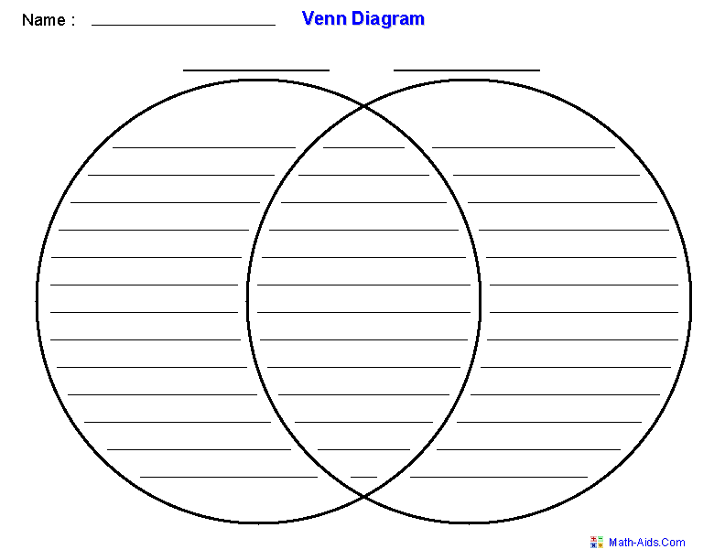
Venn Diagrams
6 facts
per sections
Mixtures
Solutions
6 facts
per sections
1 colored
picture per section
1 colored
picture per section

Slide 19
Pre/Post Activity Questions
What is a solution and why are solutions considered a homogeneous mixture?
What is the difference between an mixture and a solution?
What is a suspension?
How are suspensions different from a heterogeneous mixture and a homogeneous solution?
How are suspensions different from a heterogeneous mixture and a homogeneous solution?
*USE YOUR BOOK TO COMPLETE THE QUESTIONS ABOVE!

